Slide 1

Meeting Etiquette
Please be on Mute all the time.
Turn off Video, So that we can save bandwidth.
There is separate Q&A Section in End Please use that, Add questions in Google Form.
Break at 5 min.
Mute your microphone
To help keep background noise to a minimum, make sure you mute your microphone when you are not speaking.
Be mindful of background noise
Avoid multitasking
All links and Slides will be shared.

Slide 2

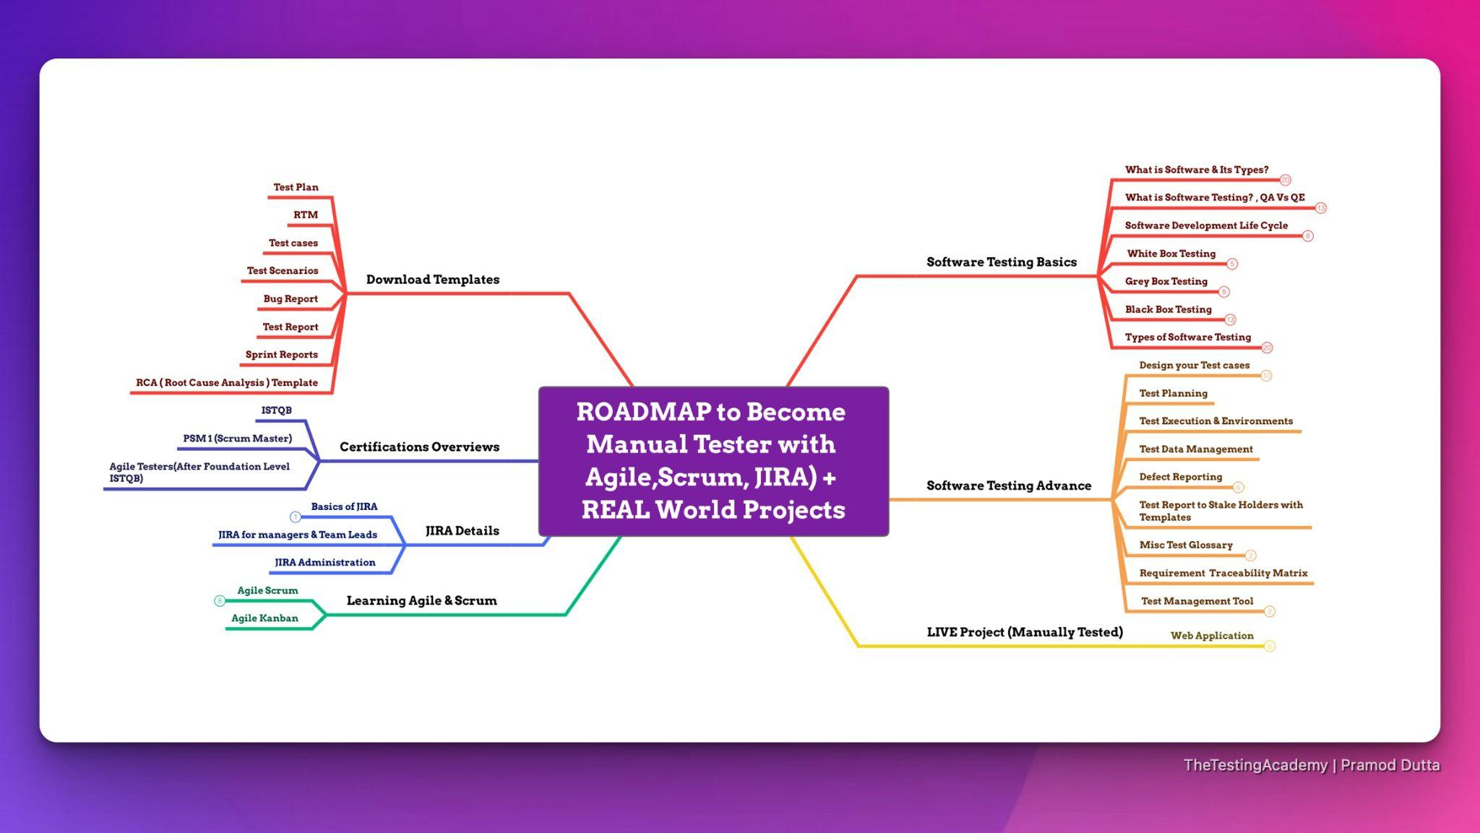
{ Software Tester } BluePrint.
Pramod Dutta
Exact BluePrint.
You Need to Become Software Tester.

Slide 3
Agenda
Introduction to Software Testing?
Details on SDLC and Different Models.
STLC Life Cycle & 7 Principles of Software Testing.
RTM & Different Types of Software Testing.
Test Design Techniques
Bugs, Severity vs Priority

Slide 4

Rules
Focus on One Thing.
5% : 95% Rule
70% is Perfect 100% is Failure
New Action

Slide 5
Commitment! Block at least
7-8 hour Per Week.

Slide 6
Laptop - 8 GB Ram, 512 GB HDD (SDD)
Mobile - Yes
Excel, PDF
Resume Building, LinkedIn,
ChatGPT(How to get Job)

Slide 7
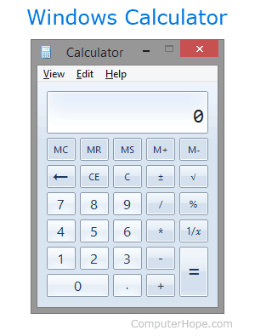
What is Software?
Software is basically a set of instructions or commands that tells a computer what to do

Slide 8
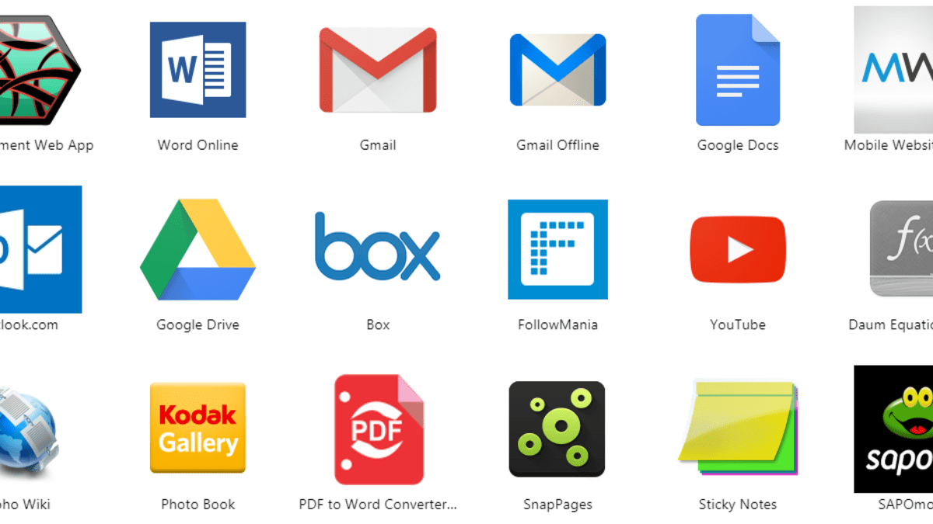
What is Software?

Slide 9
Types of Softwares
• System software
Ex: Device drivers, Operating Systems, Servers, Utilities, etc.
• Programming software
Ex: compilers, debuggers, interpreters, etc.
• Application software
Ex: Web Applications, Mobile Apps, Desktop Applications etc

Slide 10
Types of Software
System Software
Application Software
Application software is designed to perform a specific task for end-users
System software basically controls a computer’s internal functioning and also controls hardware devices such as monitors, printers, and storage devices, etc
It is a product or a program that is designed only to fulfill end-users’ requirements
General Purpose Software
MS-Word, MS-Excel, PowerPoint, etc.
Customized Software
airline reservation system
Utility Software
antivirus, disk fragmenter, memory tester, disk repair, disk cleaners
Written in a high-level language
Operating System
Language Processor
Device Driver
Written in a low-level language
Driver software. ...
Middleware. ...
Programming software.

Slide 11
What is Software Testing

Slide 12
Software testing is the process of evaluating and verifying that a software product or application does what it is supposed to do.
Expect Result ( Requirement) = Actual Result ( By doing it / QA)

Slide 13
Software Testing is a part of software development process.

Slide 14
Main Objective of testing is to release quality product to the client.

Slide 15
Activity to detect and identify the defects in the
Software. (Not Fix)

Slide 16
What are software testing objectives and purpose?

Slide 17
What are software testing objectives and purpose?
To prevent defects.
Finding defects
end result meets the business and user requirements.
Gaining confidence in and providing information about the level of quality
ensure that it satisfies the BRS that is Business Requirement
gain the confidence of the customers by providing them a quality product.

Slide 18
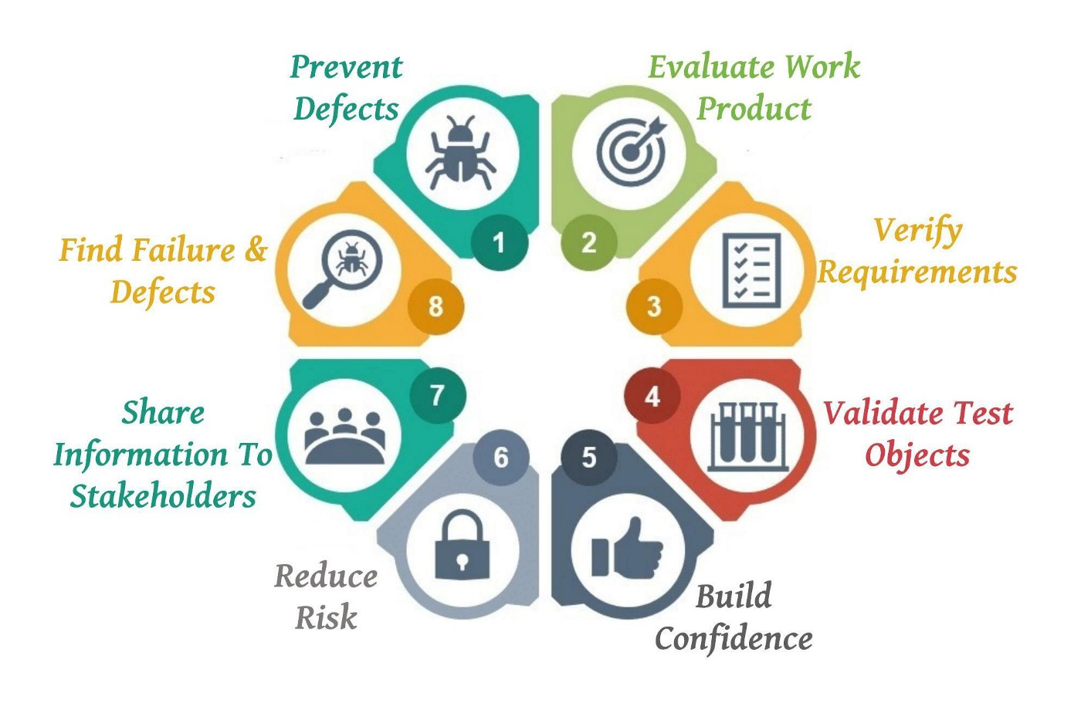

Slide 19
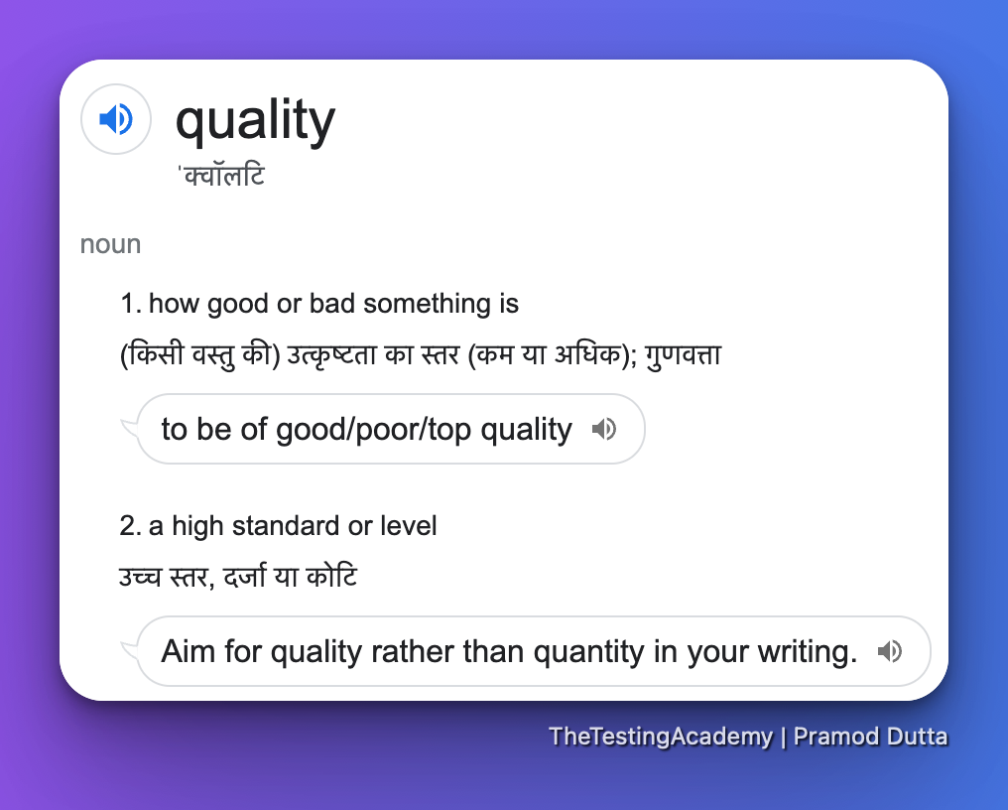
Quality
Quality is defined as justification of all the requirements of a customer in a product.

Slide 20
Quality software is Means
Bug-free
Delivered on time.
Within budget.
Meets requirements and/or expectations.
Maintainable

Slide 21
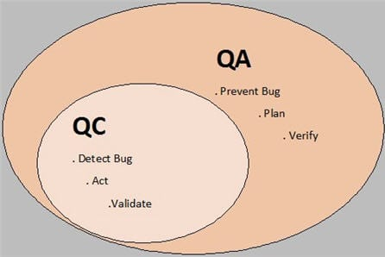

Slide 22
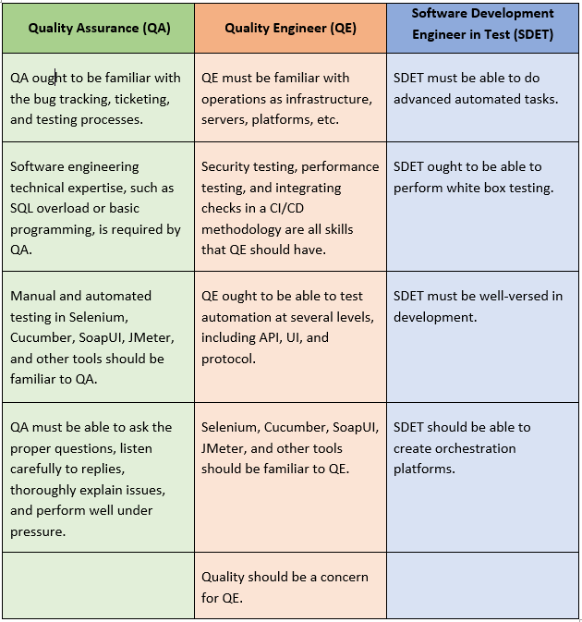

Slide 23
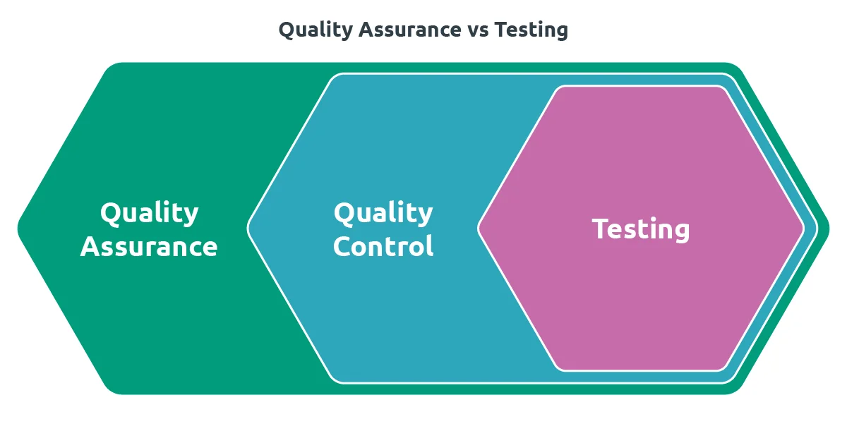

Slide 24
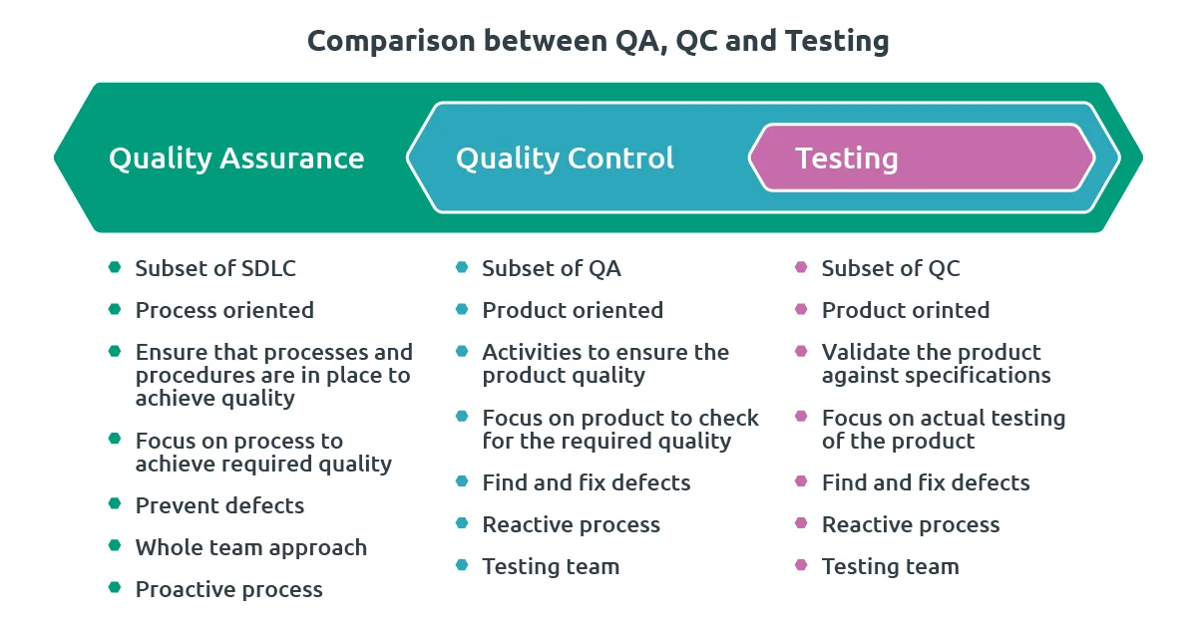

Slide 25
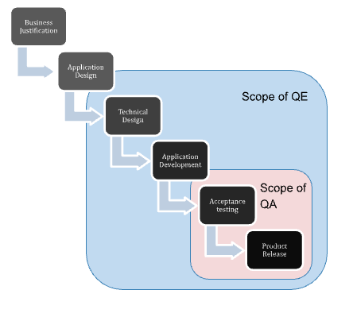

Slide 26
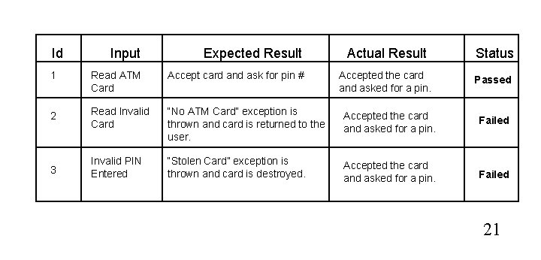
Software Testing
To check whether the Actual software product matches Expected requirements and to ensure that software product is Defect free.

Slide 27
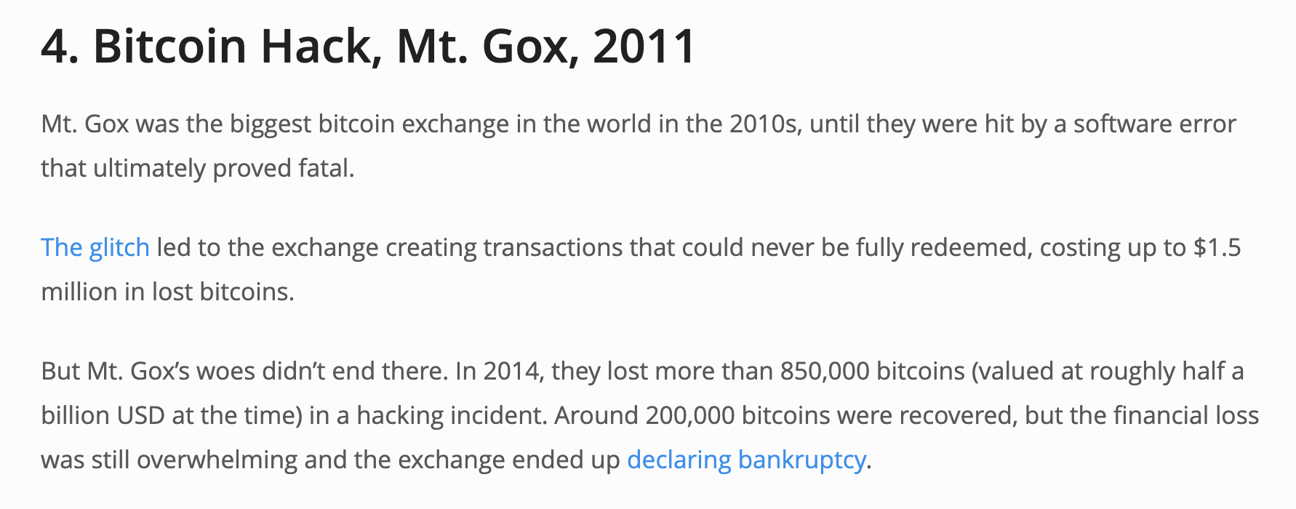
Why Software Testing is Important?
https://raygun.com/blog/costly-software-errors-history/

Slide 28
Why Software Testing is Important?
Vulnerability in Windows 10. This bug enables users to escape from security sandboxes through a flaw in the win32k system
China Airlines Airbus A300 crashed due to a software bug on April 26, 1994, killing 264 innocents live
https://raygun.com/blog/costly-software-errors-history/

Slide 29
Benefits of Software Testing
Cost-Effective
Product quality
Customer Satisfaction

Slide 30
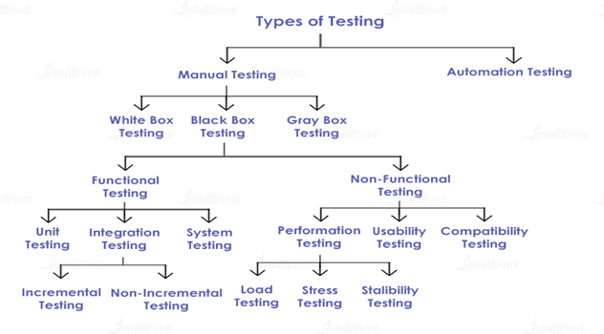

Slide 31
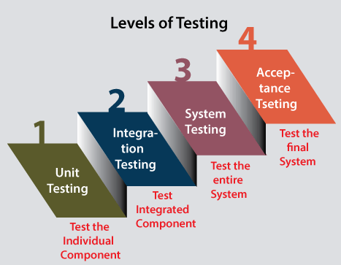

Slide 32

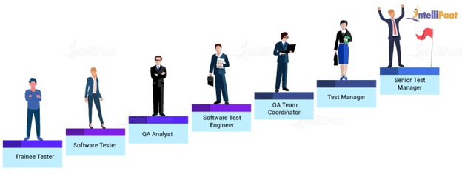

Slide 33
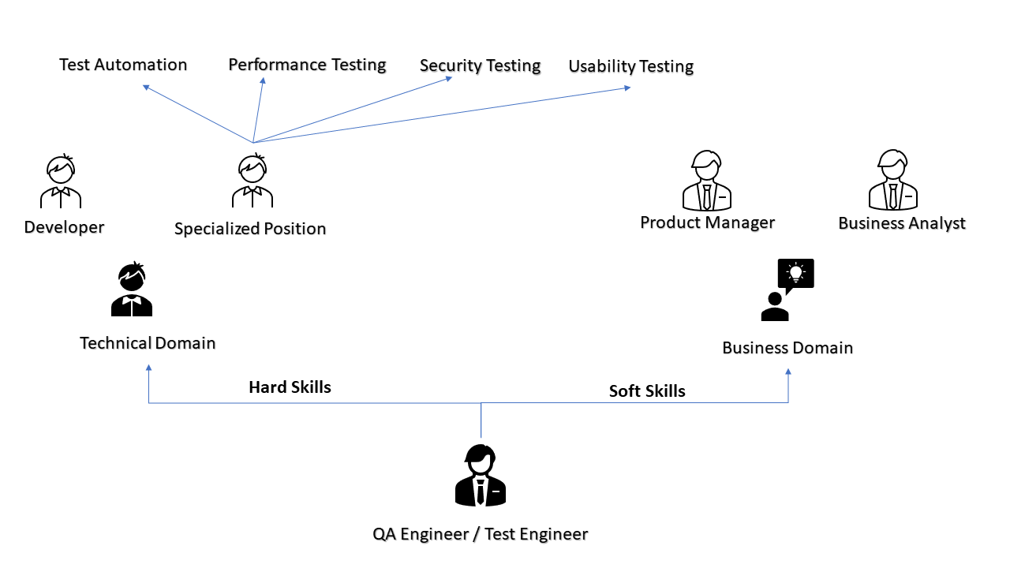

Slide 34
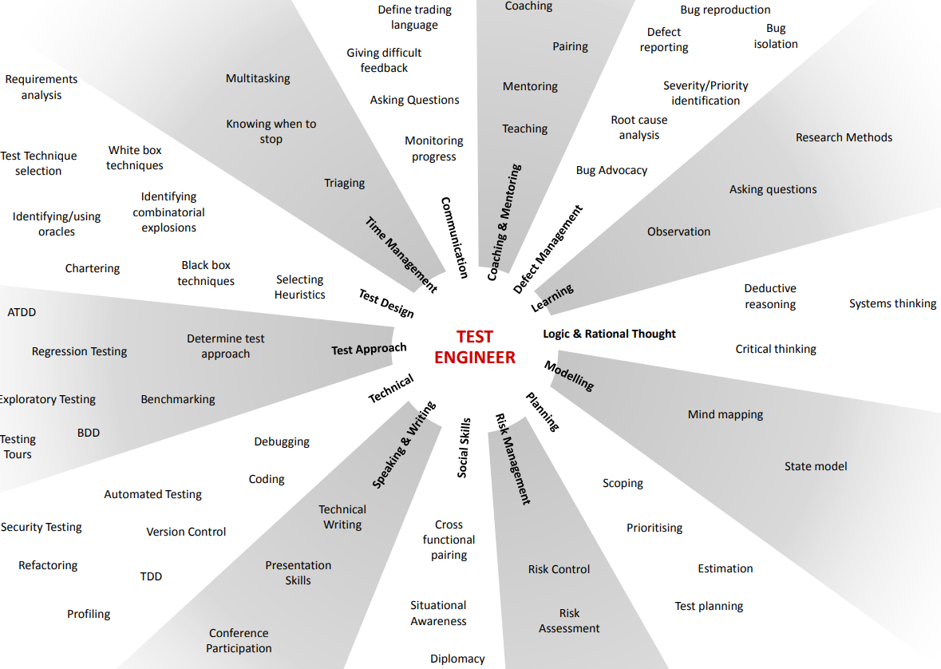

Slide 35
Types of Software Testing
Functional Testing
Non-Functional Testing

Slide 36
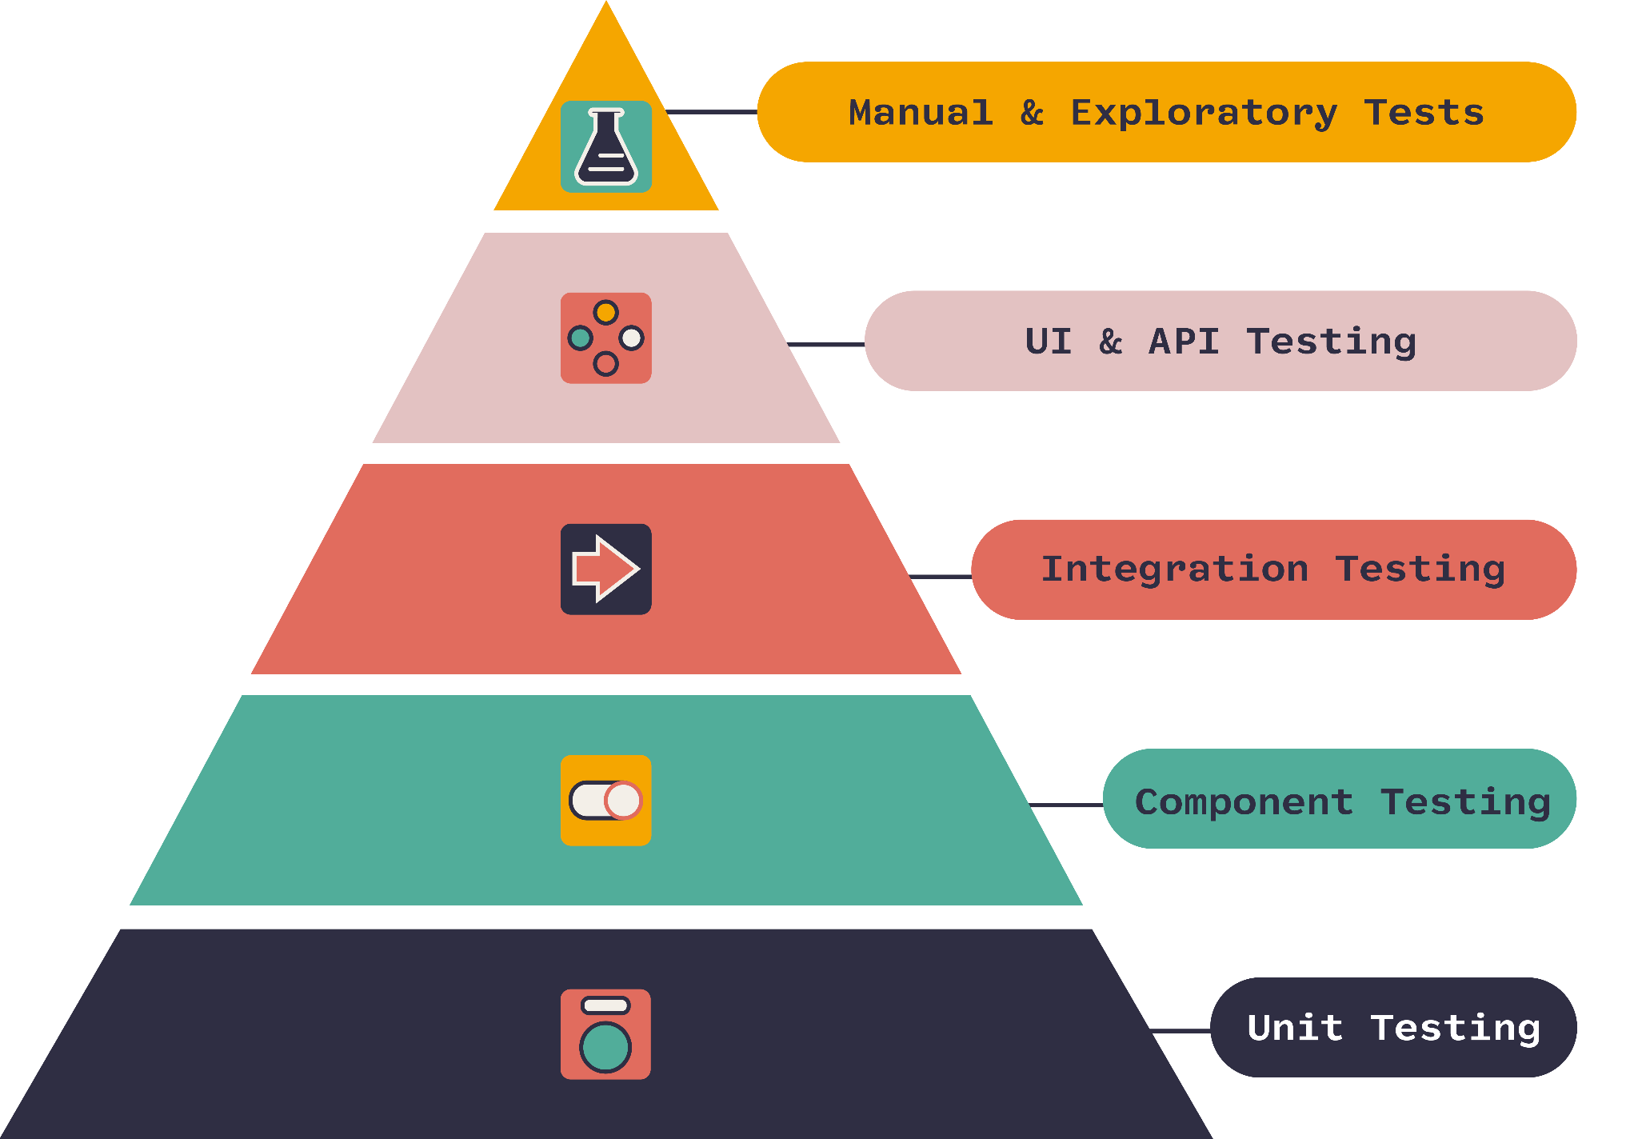
Testing Pyramid

Slide 37
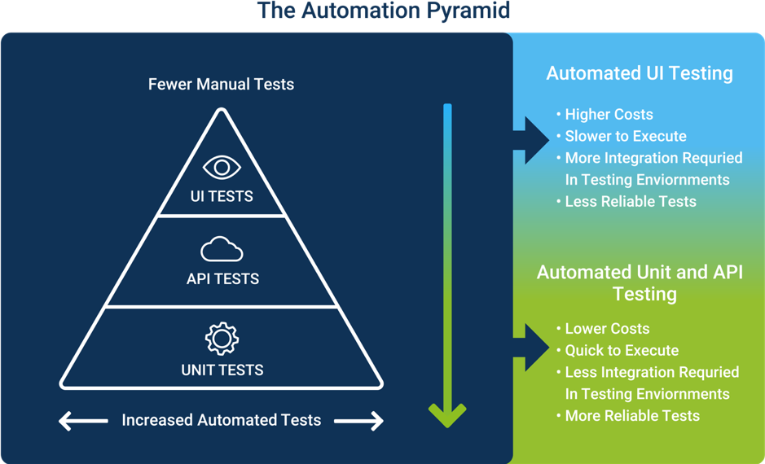

Slide 38
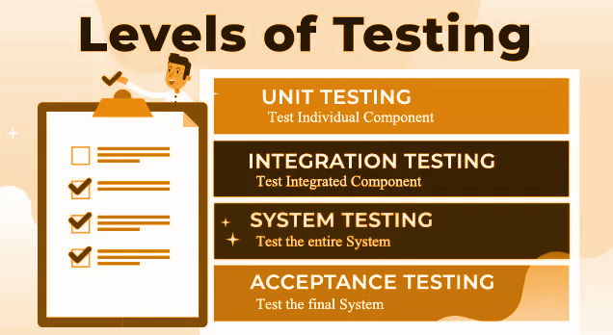

Slide 39
Unit Testing
Type of software testing where individual units or components of a software are tested
Unit tests help to fix bugs early in the development cycle and save costs.
A developer writes a section of code in the application just to test the function. They would later comment out and finally remove the test code when the application is deployed.
A coder generally uses a UnitTest Framework to develop automated test cases

Slide 40
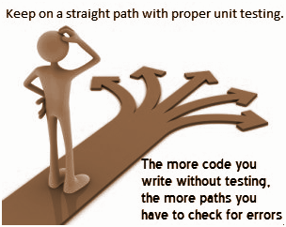
Code coverage techniques used in Unit Testing
Statement Coverage
Decision Coverage
Branch Coverage
Condition Coverage
Finite State Machine Coverage

Slide 41
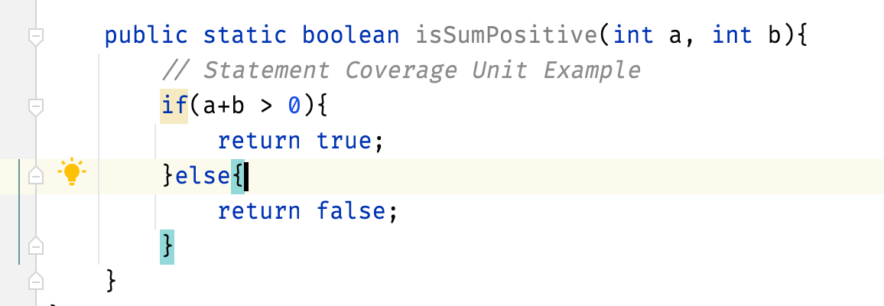
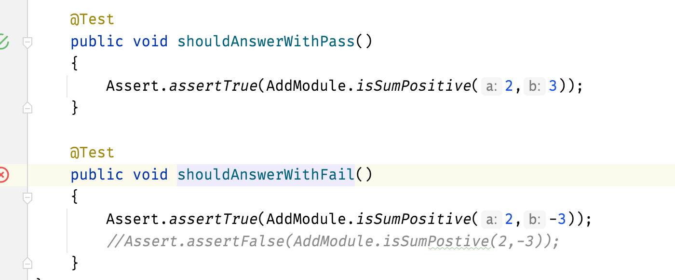
Unit Testing
Demo of Web App unit
isSumPositive function

Slide 42
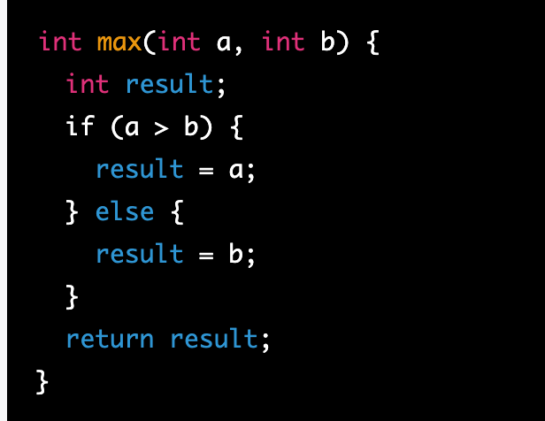
Statement Coverage!
Statement coverage is a type of software testing that aims to ensure that every statement in a program has been executed at least once during testing. This means that every line of code is tested, but not necessarily every possible path through the code.
To achieve 100% statement coverage for this code,
write a test case where a is greater than b, and another test case where b is greater than or equal to a.
This would ensure that both branches of the if statement are executed at least once, as well as the assignment and return statements.

Slide 43
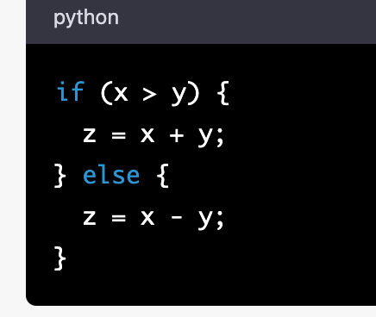
Decision Coverage
Ensuring that all possible outcomes of a decision or boolean expression have been evaluated
This means that each possible true or false outcome must be tested at least once.
To achieve 100% decision coverage,
we would need to test both the true and false outcomes of the boolean expression x > y. So,
we might write two test cases: one where x is greater than y, and one where x is not greater than y

Slide 44
Branch Coverage
Each possible path through a piece of code must be executed at least once.
we would need to test both the true and false outcomes of the boolean expression x > y,
as well as both branches of the if statement.

Slide 45
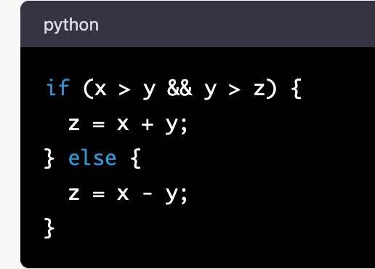
Condition Coverage
Condition coverage is similar to decision coverage, but it focuses specifically on ensuring that each possible combination of boolean sub-expressions within a decision have been evaluated
we would need to test all possible combinations of the sub-expressions x > y and y > z.
This means we would need to test the true-true, true-false, false-true, and false-false combinations.

Slide 46
Finite State Machine Coverage
Finite state machine coverage is a testing technique that focuses on ensuring that all possible states and transitions within a finite state machine have been tested.
consider a vending machine that dispenses snacks:
State 1: Idle
-> Money inserted: transition to state 2
State 2: Selecting product
-> Product selected: transition to state 3
-> Money refunded: transition to state 1
State 3: Dispensing product
-> Product dispensed: transition to state 1
To achieve 100% finite state machine coverage, we would need to test every possible combination of starting state and transitions within the machine.

Slide 47
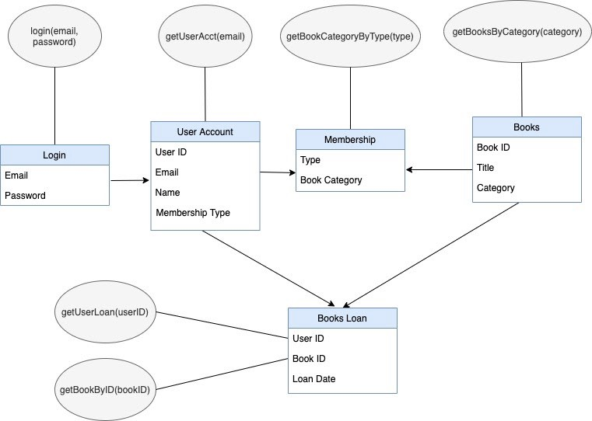
Integration Testing
Type of software testing where 2 or more unit combined.
Software modules are integrated logically and tested as a group.
Testing flow of data/information between the modules.

Slide 48
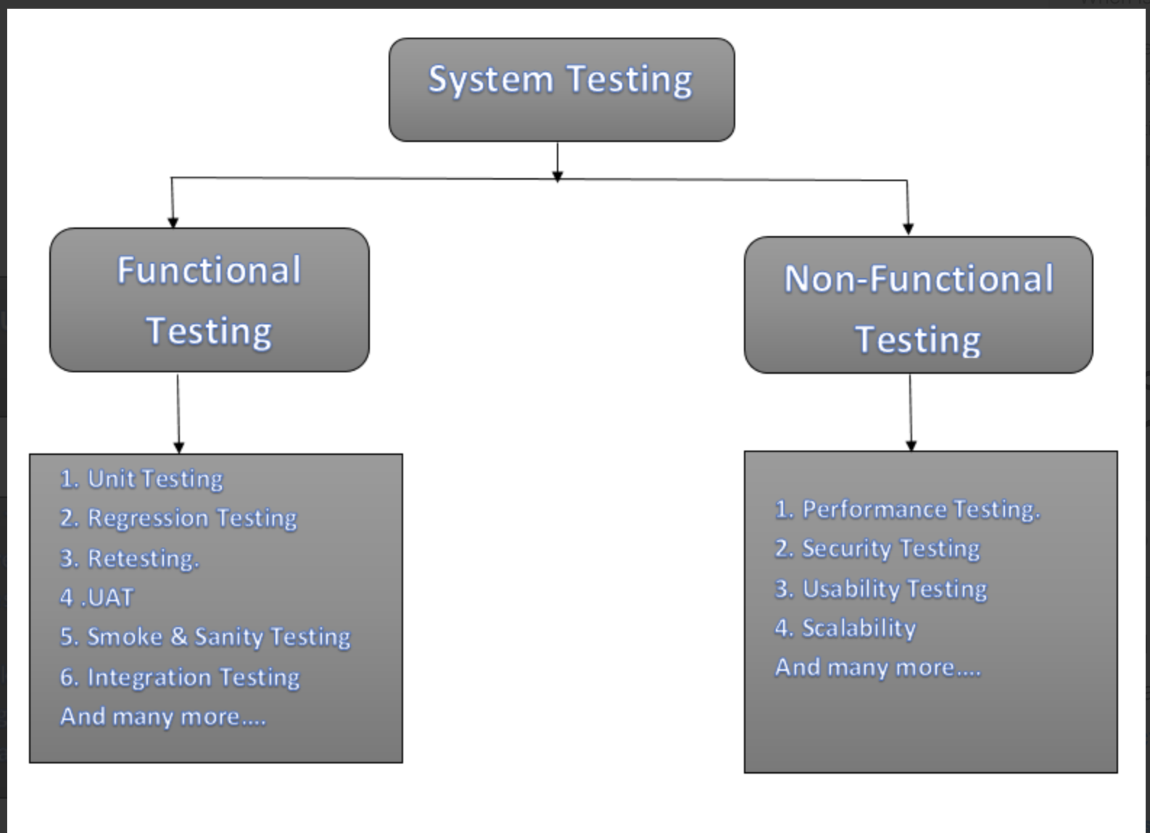
System Testing
System testing is a testing level in which tests are performed to know if a complete build aligns with functional and nonfunctional requirements made for it

Slide 49
Integration Testing
The purpose of integration testing in the context of an ecommerce site would be to ensure that individual modules or components work together as expected.
For example, we might test the integration between the product catalog module and the shopping cart module to ensure that items are correctly added to the cart and that inventory is updated.
We might also test the integration between the payment processing module and the order fulfillment module to ensure that payments are correctly processed and that orders are shipped out in a timely manner.
The test environment would be a testing environment with simulated interactions, and the test data would be specific to each module or component being tested.

Slide 50
System Testing
The purpose of system testing in the context of an ecommerce site would be to verify that the entire system works as expected, from the user's perspective.
This would involve testing a range of user scenarios, such as browsing products, adding items to the cart, checking out, and making payments.
The test environment would be production-like, and the test data would be representative of the types of products, users, and transactions that the site is expected to handle.

Slide 51
Acceptance testing
Acceptance testing is usually the final stage of testing before the software is deployed, and it is typically conducted by the end-users, stakeholders, or other representatives of the business who are responsible for ensuring that the software meets their needs.
User Acceptance Testing (UAT): In this type of testing, end-users or other stakeholders test the software in a real-world scenario to ensure that it meets their specific business requirements. The purpose of UAT is to verify that the software is usable and meets the needs of the users.
Business Acceptance Testing (BAT): In this type of testing, representatives from the business side of the organization test the software to ensure that it meets the overall business goals and objectives. The purpose of BAT is to verify that the software aligns with the organization's strategic direction and that it will provide the intended value.

Slide 52
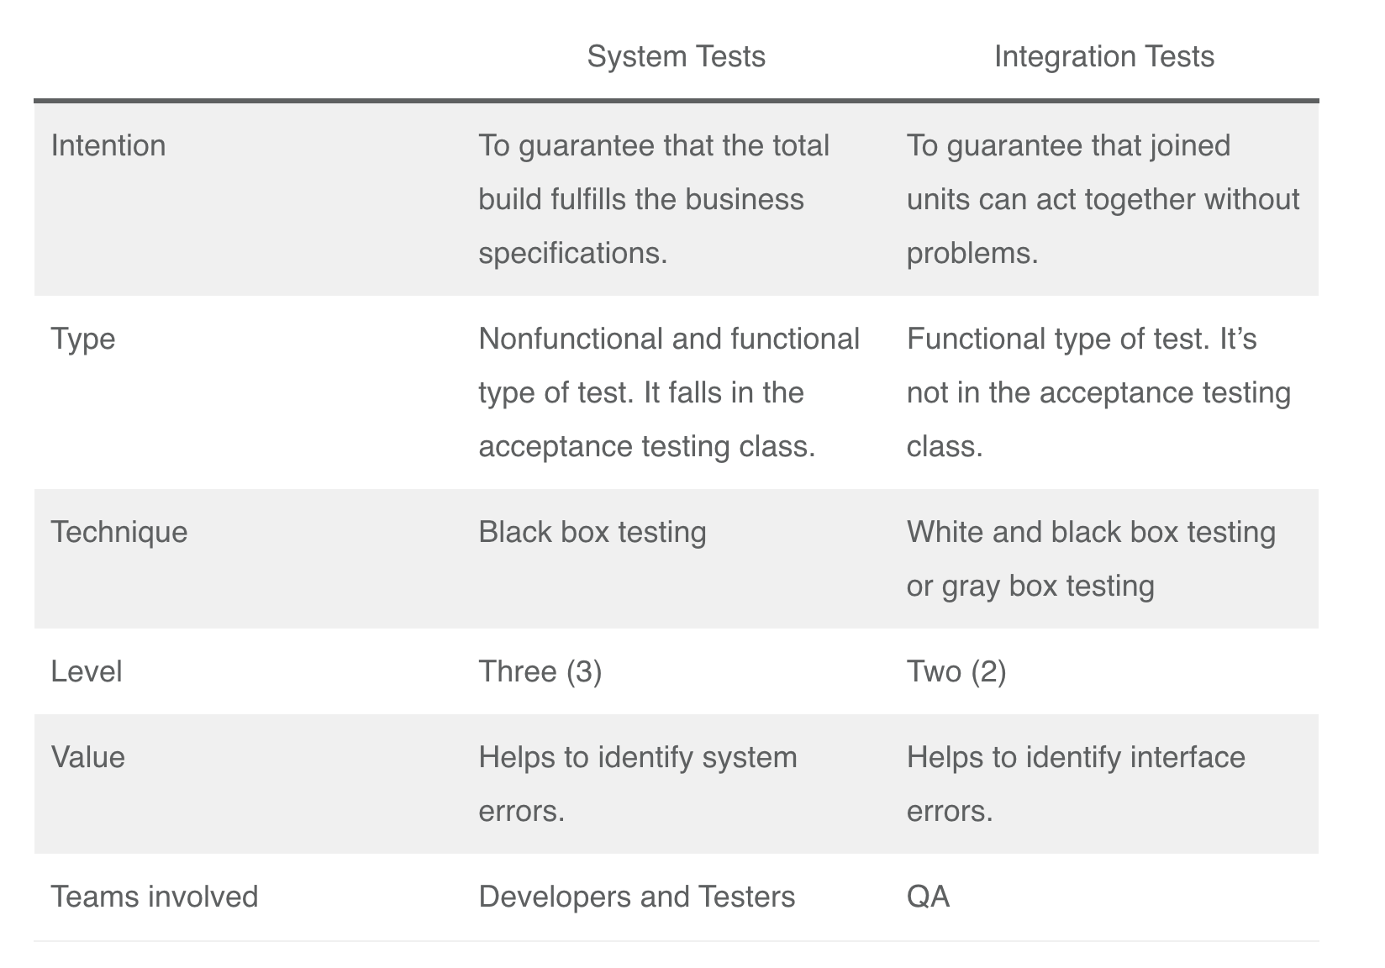
System Testing vs Integration Testing

Slide 53
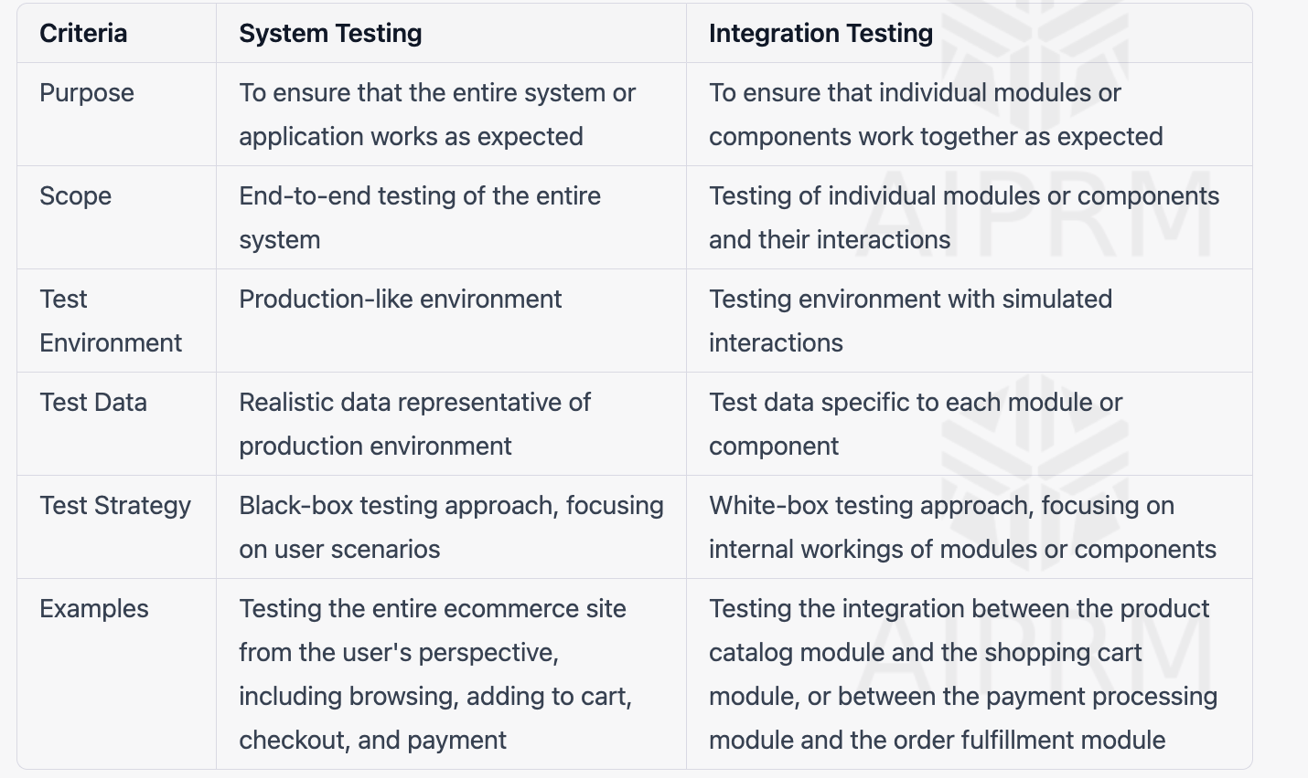
System Testing vs Integration Testing

Slide 54
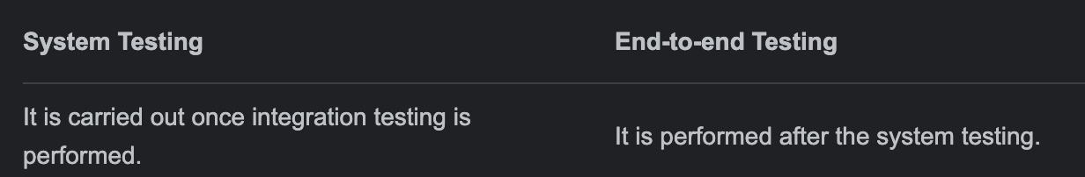
System Testing vs E2E Testing

Slide 56
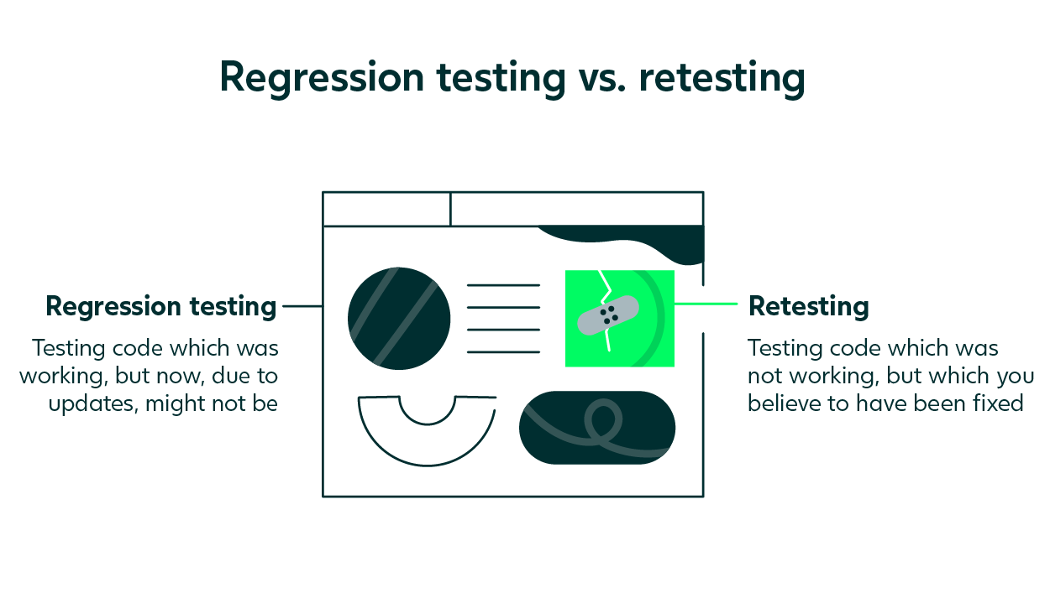

Slide 57
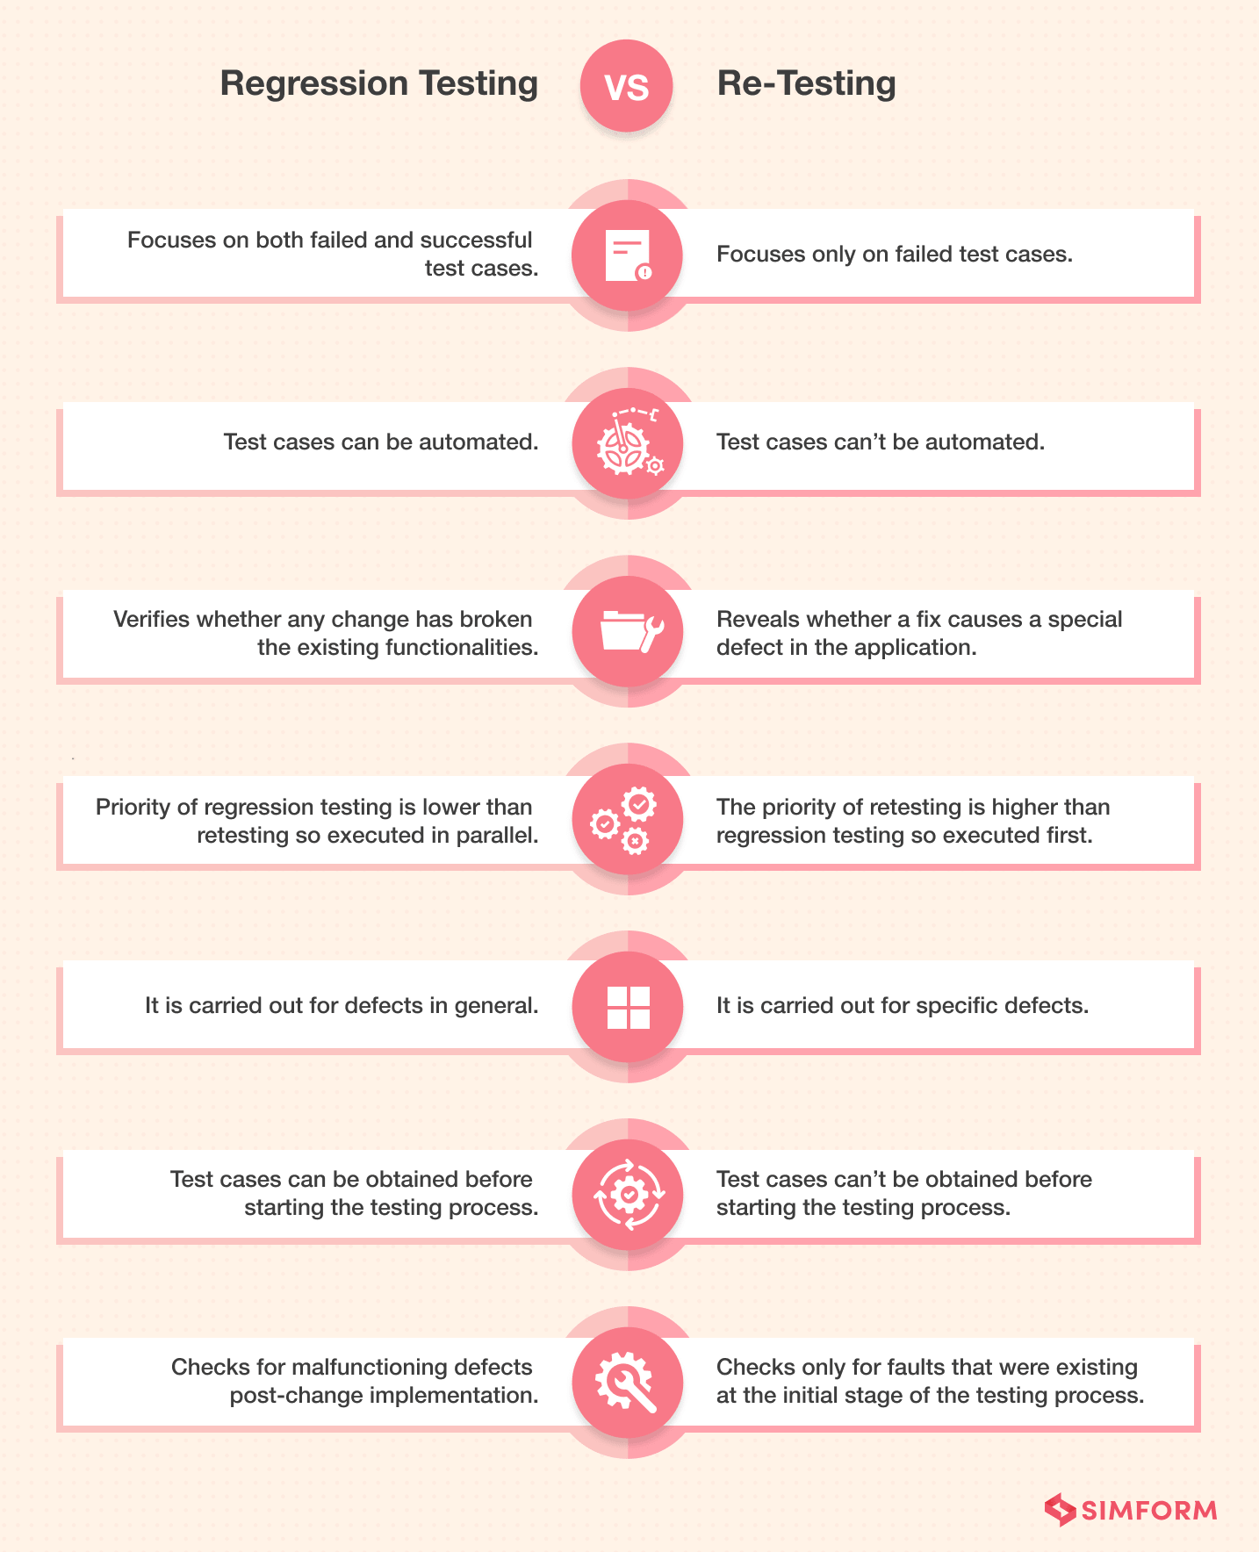

Slide 58
Manual Tester / Software Tester
Roles and Responsibilities

Slide 59
Manual Tester / Software Tester
Roles and Responsibilities
Gather requirements from team
Prepare Test Plan, Test Scenarios, Test cases - https://sdet.live/3DbA
Verifying the Software Web/ App by Hand
Execute the Test cases and Report Bugs
Send Test report to stakeholders
More concentrated on the UI/UX issues
In charge of paperwork(aka documentation online)

Slide 60
Manual Tester Roles and Responsibilities
Test environment setup
Participation in meetings
Analysis of customer requests
Software bug tracking
Analysis and execution of test cases
Maintaining contact with test managers

Slide 61
What you do can extra? As Manual tester
Help in preparing the requirements to PM
Share a Video or Images of the Manual flows to
automation team, so that they can create better automation.
Help the team pm, devs to sync and come with timelines
of release.
Learn coding and help in automation of the flows
manual tested.
Identify the automation flows and pain manual areas
automate them using scripts

Slide 62
What you do can extra? As Manual tester
https://forms.gle/KcCe2bhZSFsS5GzLA

Slide 63
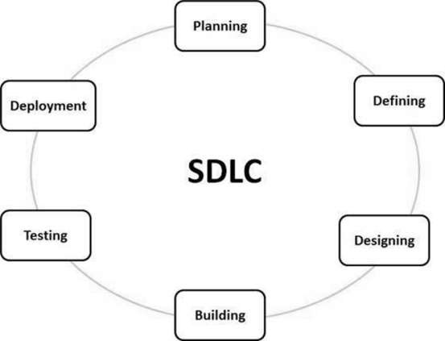
Software Development Life Cycle
Software Development Life Cycle (SDLC) is a process used by the software industry to design, develop and test high quality softwares.
ISO/IEC 12207 is an international standard for software life-cycle processes. It aims to be the standard that defines all the tasks required for developing and maintaining software.

Slide 64
Planning and Requirement Analysis
It is performed by the senior members of the team with inputs from the customer.
Sales department, market surveys and domain experts in the industry.
Documents - Statement of Work, Project Plan
Outcome - Various Technical approaches that can be followed to implement the project successfully with minimum risks.
https://bugz.atlassian.net/l/cp/EeXpfJ0W

Slide 65
SOW-TEMPLATE-Project Manager-ND
https://docs.google.com/document/d/1oP7Fw3RTvCdYuc1sH_1MeRYzOUhmtapr/edit?usp=sharing&ouid=104755920778477387077&rtpof=true&sd=true

Slide 66
2. Defining Requirements
Define and document the product requirements and get them approved from the customer or the market analysts
Documents - SRS (Software Requirement Specification) document
https://sdet.live/samplesrs
Consists of all the product requirements to be designed and developed during the project life cycle.
https://www.geeksforgeeks.org/software-requirement-specification-srs-format/

Slide 67
3. Designing
Based on the requirements specified in SRS, usually more than one design approach for the product architecture is proposed and documented in a DDS - Design Document Specification
Documents - DDS
https://sdet.live/samplesrs
A design approach clearly defines all the architectural modules of the product along with its communication and data flow representation

Slide 68
4. Building
The programming code is generated as per DDS during this stage
Documents - FRDs
https://sdet.live/samplesrs
Developers must follow the coding guidelines defined by their organization and programming tools like compilers, interpreters, debuggers

Slide 69
5. Testing
This stage refers to the testing only stage of the product where product defects are reported, tracked, fixed and retested, until the product reaches the quality standards defined in the SRS.
Documents - multiple Docs
https://sdet.live/notes
Full STLC Life Cycle

Slide 70
6. Deployment
Once the product is tested and ready to be deployed it is released formally in the appropriate market.
Documents - NA
The product may first be released in a limited segment and tested in the real business environment (UAT- User acceptance testing).

Slide 71
BRD
Business Requirement Document i.e. BRD is created during the initial phase of the project. This document contains the high-level business requirements that could be easy to follow by business stakeholders, managers, board of directors, etc.
a business requirement document is a functional business requirement that is written in a well-structured manner without any technical jargon.
Bank customers should be able to register themselves.
Registered bank customers should be able to log in.
Customers should be able to do online transactions.
Customers should be able to open fixed deposit online.
Customers should be able to recharge their mobile phones, etc.

Slide 72
FRD
Functional specification document is required with detailed requirements in technical terms that will be referred by the technical team for further development of the system.
Username should not include numeric value.
The password should be 8 or more char long.
Only 5 transactions should be allowed in a day, etc

Slide 73
SRS
Software Requirement Specification i.e. SRS Document is one of the important documents for the development team. It is a complete description of the behavior of a system to be developed.
SRS document contains all the functional and non-functional requirements along with the use cases that the software must meet.
Software specification requirement document elaborates on the business requirements mentioned in BRD to accommodate the functional and non-functional requirements along with user intersections with the system i.e. use cases.
document is prepared by system analysts or business analysts and referred by the project management, development, and implementation teams.

Slide 74
UML (Unified Modeling Language) is a visual modeling language that is widely used in software engineering to represent software designs.
Standard language used for modeling software systems, and it includes various diagrams such as class diagrams, use case diagrams, sequence diagrams, and state diagrams.
Use case diagrams are a type of UML diagram that is often used in software testing
Use case diagrams help testers understand the system's requirements and how it will be used by end-users.

Slide 75
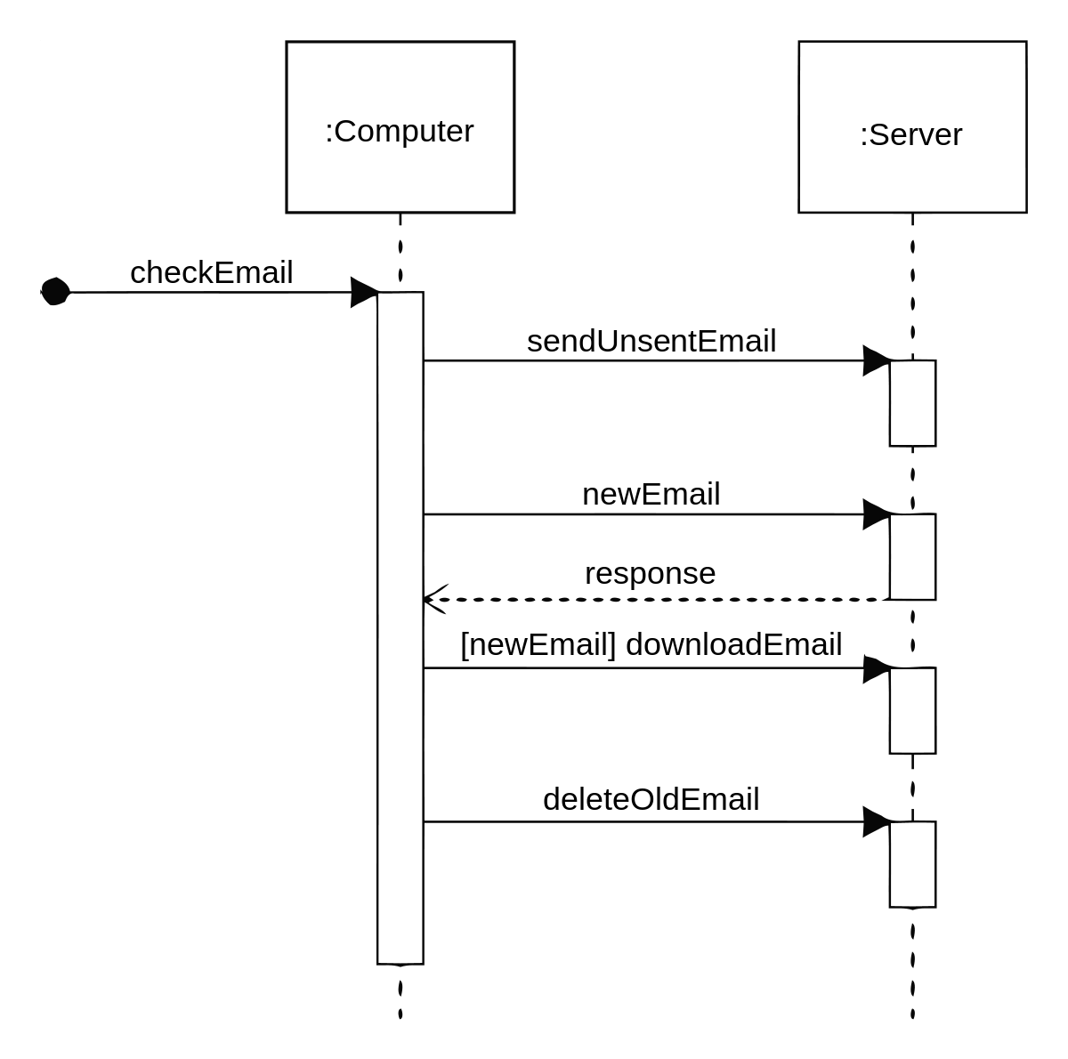
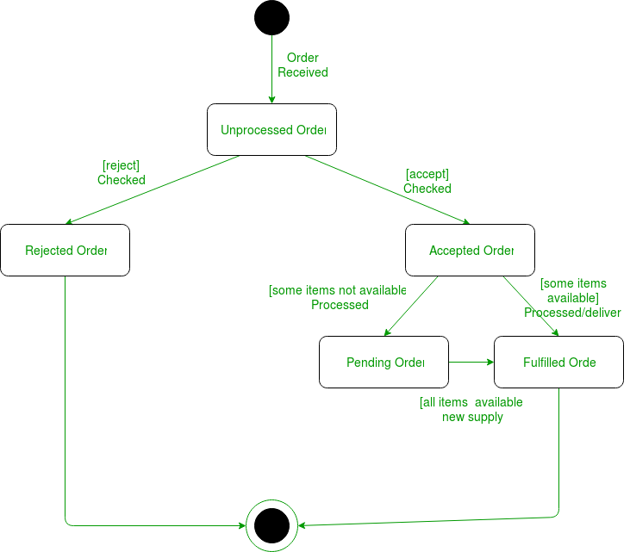
sequence diagrams, and state diagrams.

Slide 76
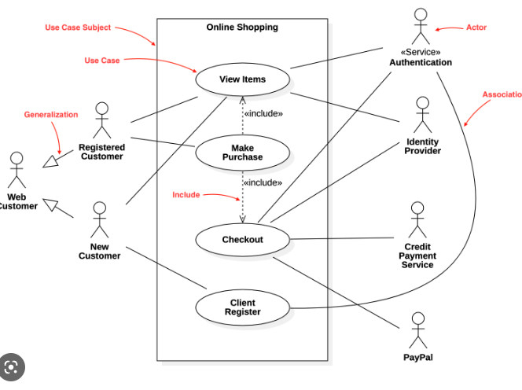

Slide 77
UML contains different diagrams and Use case is one of it
UML also contains Structural diagrams as well as - such as Class Diagram

Slide 78
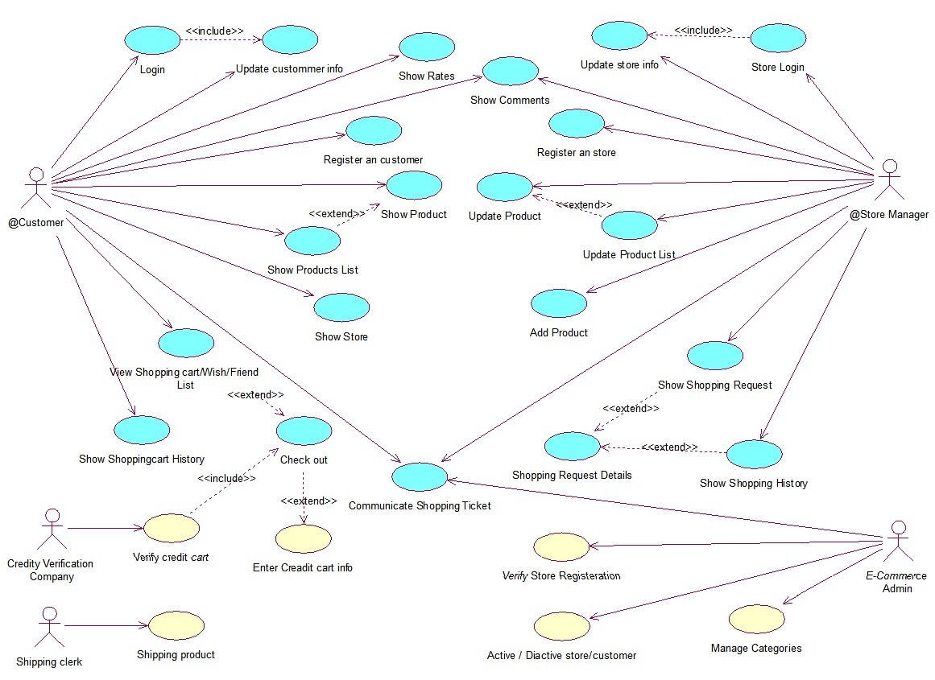
https://stackoverflow.com/questions/9107448/uml-class-diagram-for-an-e-commerce-website

Slide 79
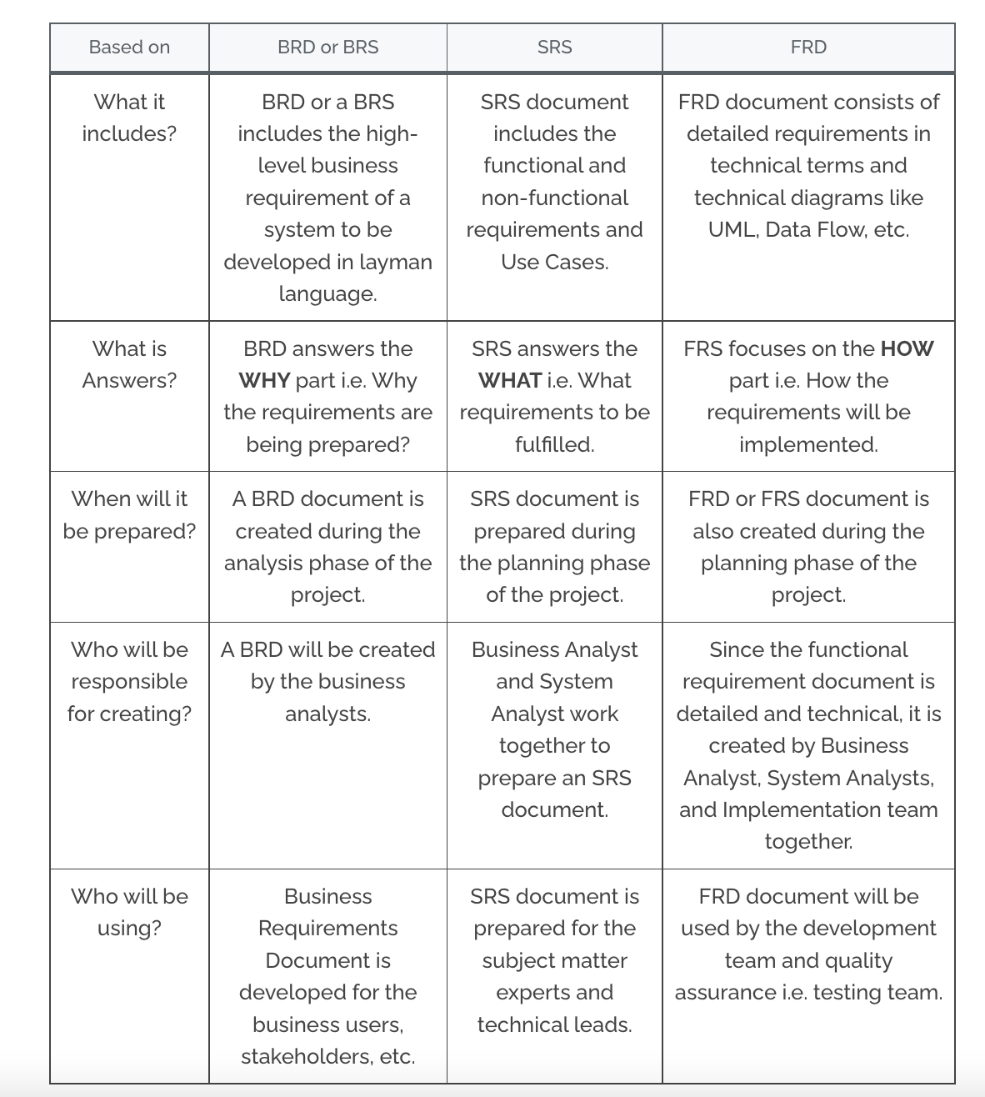

Slide 80
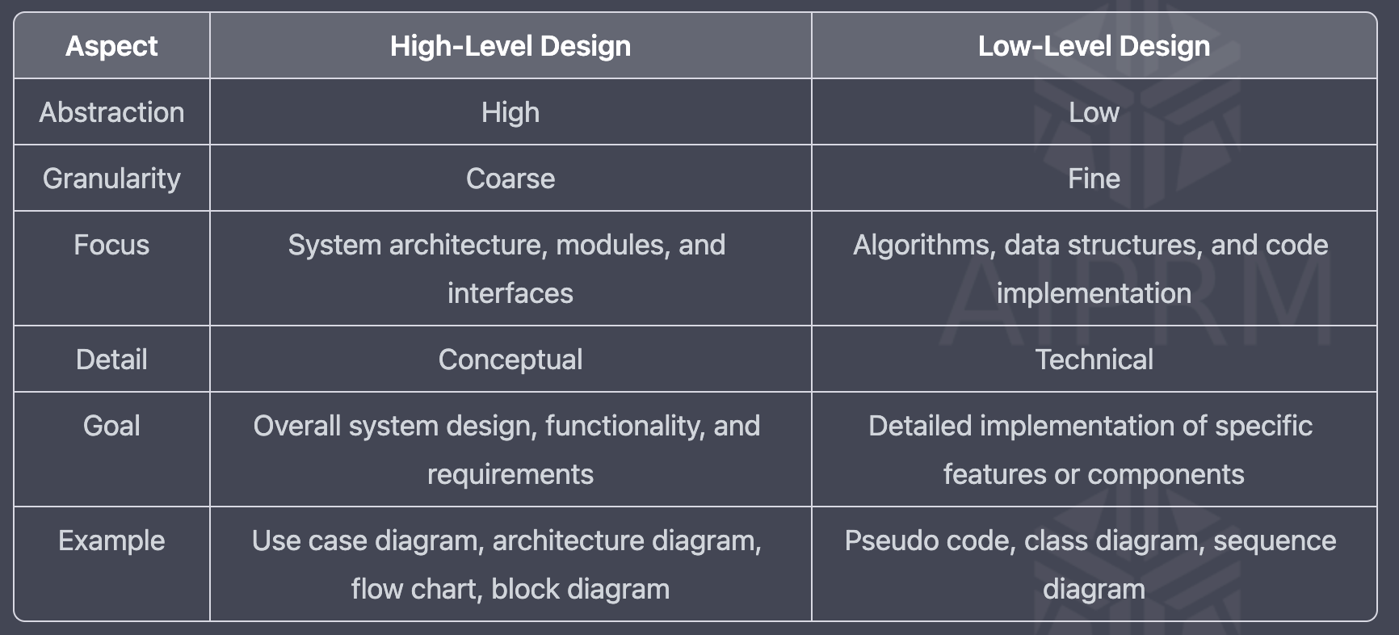

Slide 81
SDLC Models
Waterfall Model
Spiral Model
V-Model
Agile Model
Other related methodologies are Agile Model, RAD Model, Rapid Application Development and Prototyping Models.

Slide 82
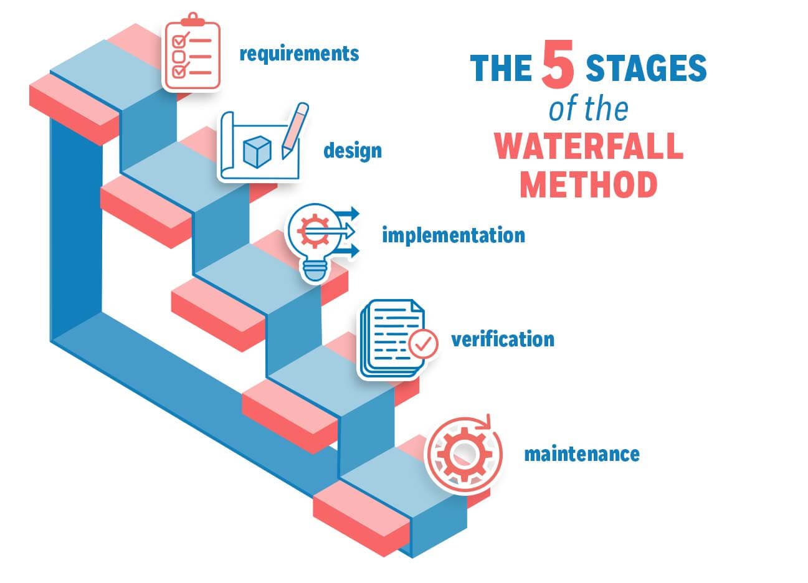
Waterfall Model

Slide 83
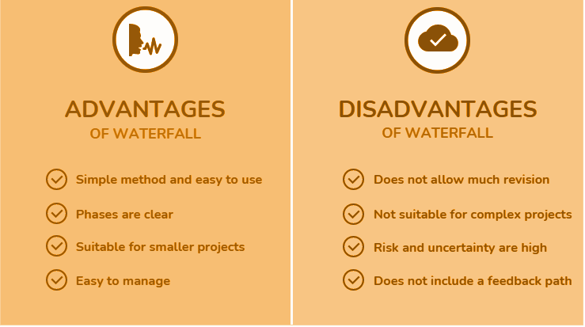
Waterfall Model

Slide 84
Advantages of Waterfall Model
The product will be of high quality.
There are less possibilities of detecting problems because requirement modifications are prohibited.
Since the testers are employed later, the initial cost is lower.
Preferred for little projects with frozen criteria.

Slide 85
Disadvantages of Waterfall Model
• Requirement changes are not allowed.
• If there is defect in Requirement that will be continued in later phases.
• Total investment is more because time taking for rework on defect is time consuming which leads to
high investment.
• Testing will start only after coding

Slide 86
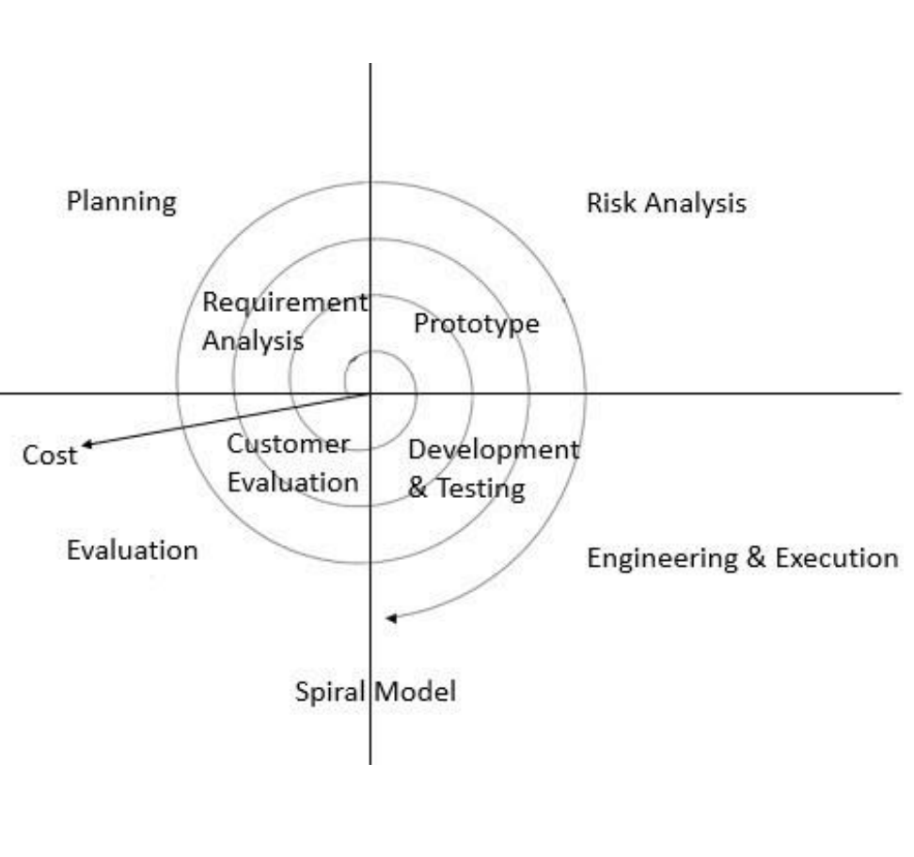
Spiral Model
Spiral Model is iterative model.
▪ Spiral Model overcome drawbacks of Waterfall model.
▪ We follow spiral model whenever there is dependency on the modules.
▪ In every cycle new software will be released to customer.
▪ Software will be released in multiple versions. So it is also called version control model.

Slide 87
The Radius of the spiral at any point represents the expenses(cost) of the project so far, and the angular dimension represents the progress made so far in the current phase.

Slide 88
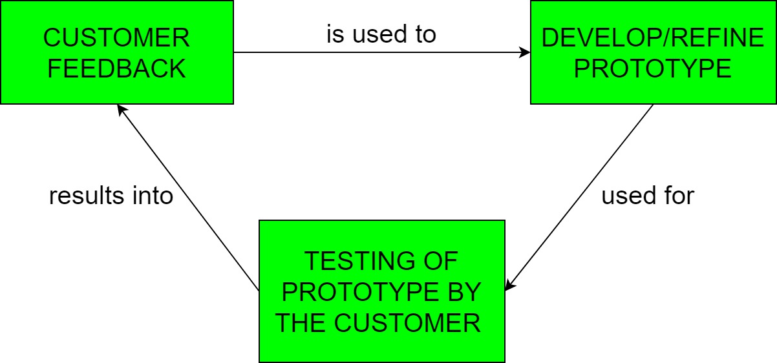
Prototyping Model
Prototyping is defined as the process of developing a working replication of a product or system that has to be engineered. It offers a small scale facsimile of the end product and is used for obtaining customer feedback as described below:

Slide 89
In each phase of the Spiral Model, the features of the product dated and analyzed, and the risks at that point in time are identified and are resolved through prototyping.
Thus, this model is much more flexible compared to other SDLC models.

Slide 90
Risk Handling in Spiral Model
A risk is any adverse situation that might affect the successful completion of a software project. The most important feature of the spiral model is handling these unknown risks after the project has started. Such risk resolutions are easier done by developing a prototype. The spiral model supports coping up with risks by providing the scope to build a prototype at every phase of the software development.

Slide 91
Advantages of Spiral Model
• Testing is done in every cycle, before going to the next cycle.
• Customer will get to use the software for every module.
• Requirement changes are allowed after every cycle before going to the next cycle.

Slide 92
Disadvantages of Spiral Model
• Requirement changes are NOT allowed in between the cycle.
• Every cycle of spiral model looks like waterfall model.
• There is no testing in requirement & design phase.

Slide 93
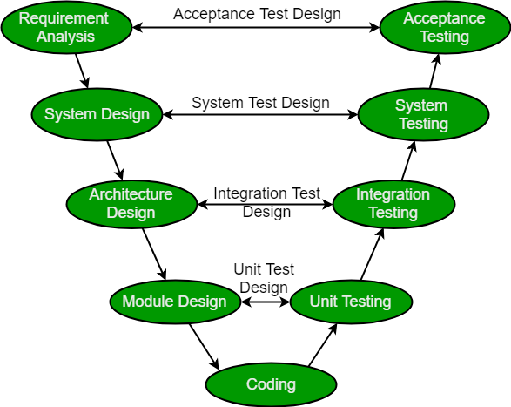
V-Model
The V-model is a type of SDLC model where process executes in a sequential manner in V-shape.

Slide 94
V-Model contains Verification phases on one side of the Validation phases on the other side.

Slide 95
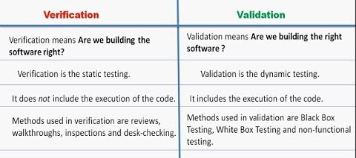

Slide 96
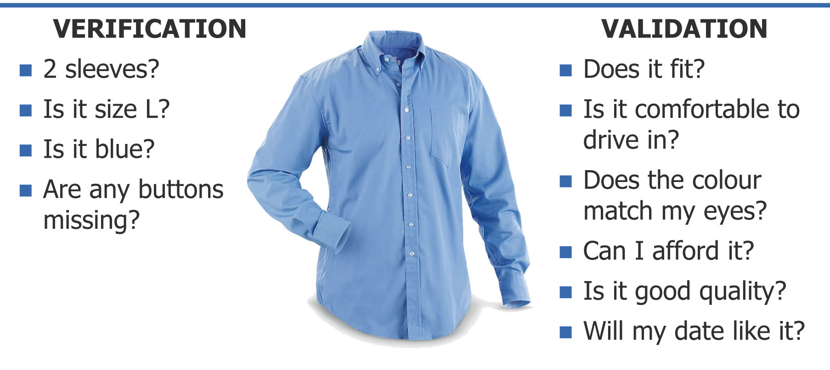

Slide 97
Verification: It involves static analysis technique (review) done without executing code. It is the process of evaluation of the product development phase to find whether specified requirements meet.
Validation: It involves dynamic analysis technique (functional, non-functional), testing done by executing code. Validation is the process to evaluate the software after the completion of the development phase to determine whether software meets the customer expectations and requirements.

Slide 98
Advantages
• Testing is involved in each and every phase.
Disadvantages
• Documentation is more.
• Initial investment is more.

Slide 99
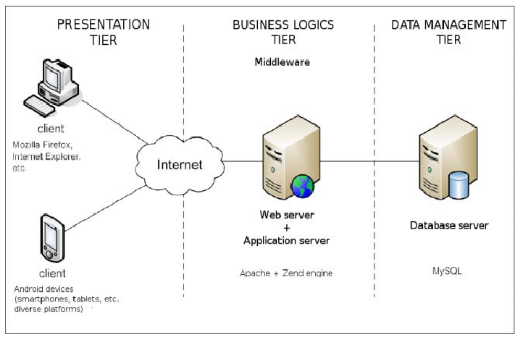

Slide 100
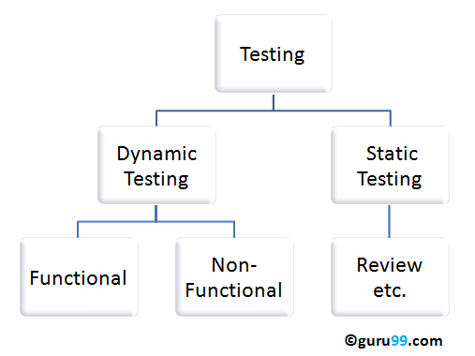
Static V/S Dynamic Testing
Static testing is an approach to test project documents in the form of Reviews,
Walkthroughs and Inspections.
Dynamic testing is an approach to test the actual software by giving inputs and
observing results.

Slide 101
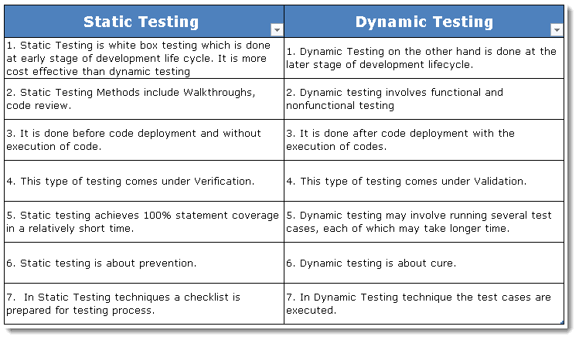

Slide 102
AGILE MODEL
The Agile model is a combination of an incremental and iterative approach and is focussed on fitting in well with flexible requirements.
Agile is an iterative approach to project management and software development that helps teams deliver value to their customers faster and with fewer headaches
the project is divided into small subparts and is delivered in iterations. The subtasks are divided into time frames to serve working functionality with each build. As a result, the final product has all the required features.

Slide 103


Slide 104
Instead of betting everything on a "big bang" launch, an agile team delivers work in small, but consumable, increments.

Slide 105
Benefits:
Quick development
Quality and measurable results
Business value can be delivered – demonstrated fast
Requires minimum resources
Highly adaptive to changing requirements

Slide 106
Better Resume Tech.

Slide 107

Software Testing Life Cycle (STLC)
Software Testing Life Cycle (STLC) is a sequence of different activities performed during the software testing process.

Slide 108


Slide 109
Requirement Analysis: Quality assurance team understands the requirements like what is to be tested. If anything is missing or not understandable then quality assurance team meets with the stakeholders to better understand the detail knowledge of requirement. - Documents - SRS, FRD, BRD
Test Planning: In this phase manager of the testing team calculates estimated effort and cost for the testing work. This phase gets started once the requirement gathering phase is completed. Documents Test Plan

Slide 110
Test Case Development: The test case development phase gets started once the test planning phase is completed Test cases. Documents - Test cases(Excel, GSheet or on Tools) Test Environment Setup: Test environment decides the conditions on which software is tested. NA Test Execution: Documents - Test Execution Report Bug Report , In this phase testing team start executing test cases based on prepared test cases in the earlier step. Test Closure: Test Report This is the last stage of STLC in which the process of testing is analyzed.

Slide 111


Slide 112


Slide 113

Static Testing
Static Testing is a type of a Software Testing method which is performed to check the defects in software without actually executing the code of the software application.

Slide 114
Static Testing done with Static Analysis
Static Analysis:
Static Analysis includes the evaluation of the code quality that is written by developers. Different tools are used to do the analysis of the code and comparison of the same with the standard.
It also helps in following identification of following defects:
(a) Unused variables
(b) Dead code
(c) Infinite loops
(d) Variable with undefined value
(e) Wrong syntax

Slide 115


Slide 116
Testing Methodologies
• White box Testing
• Black box Testing
• Grey box Testing

Slide 117


Slide 118


Slide 120

Unit Testing
A unit is a single component or module of a software.
Unit testing conducts on a single program or single module.
Unit Testing is white box testing technique.
Conducted by the developers.
Unit testing techniques:
Basis path testing
Control structure testing
Conditional coverage
Loops Coverage.
Mutation Testing

Slide 121
Unit Testing
Demo of Web App unit
isSumPositive function

Slide 122

Integration Testing
- Integration testing performed between 2 or more modules.
- Integration testing focuses on checking data communication between multiple
modules.
- Integrated Testing is white box testing technique

Slide 123
Integration Testing
Incremental
Big Bang Approach

Slide 124
Big Bang Approach
All the components or modules are integrated together at once and then tested as a unit.
some interfaces link to be tested could be missed easily.
Convenient for small systems.
Since the Integration testing can commence only after “all” the modules are designed, the testing team will have less time for execution in the testing phase.
We might miss data flow between some of the modules.
If you find any defect we can’t understand the root cause of defect
high-risk critical modules are not isolated and tested on priority.

Slide 125
Incremental Integration Testing
Testing is done by integrating two or more modules that are logically related to each other and then tested for proper functioning of the application.
Then the other related modules are integrated incrementally and the process continues until all the logically related modules are integrated and tested successfully.

Slide 126


Incremental Integration Testing

Slide 127
Incremental Integration Testing
Testing is done by integrating two or more modules that are logically related to each other and then tested for proper functioning of the application.
Then the other related modules are integrated incrementally and the process continues until all the logically related modules are integrated and tested successfully.

Slide 128


Top-down Integration Testing
We will add the modules incrementally or one by one and test the data flow in similar order as we can see in the below diagram:

Slide 129
Difference between Stubs and Drivers
The Stubs and Drivers are considered as elements which are equivalent to to-do modules that could be replaced if modules are in their developing stage, missing or not developed yet
Stubs are mainly used in Top-Down integration testing while the Drivers are used in Bottom-up integration testing, thus increasing the efficiency of testing process.

Slide 130
Difference between Stubs and Drivers
Module-A : Login page website,
Module-B : Home page of the website
Module-C : Profile setting
Module-D : Sign-out page
Assume Module-A is developed. As soon as it’s developed, it undergoes testing, but it requires Module-B, which isn’t developed yet. So in this case, we can use the Stubs or Drivers that simulate all features and functionality that might be shown by actual Module-B. So, we can conclude that Stubs and drivers are used to fulfill the necessity of unavailable modules.

Slide 131
Difference between Stubs and Drivers
S.No. | Stubs | Drivers
1. | Stubs are used in Top-Down Integration Testing. | Drivers are used in Bottom-Up Integration Testing.
2. | Stubs are basically known as a “called programs” and are used in the Top-down integration testing. | While, drivers are the “calling program” and are used in bottom-up integration testing.
3. | Stubs are similar to the modules of the software, that are under development process. | While drivers are used to invoking the component that needs to be tested.

Slide 132
Top-down Integration Testing
To detect the significant design flaws and fix them early because required modules are tested first.
Critical Modules are tested on priority; major design flaws could be found and fixed first.

Slide 133


Bottom Up Integration Testing
Low lower-level modules are tested with higher-level modules until all the modules have been tested successfully.
Critical modules (at the top level of software architecture) which control the flow of application are tested last and may be prone to defects.

Slide 134
S.NO. | Comparison Basis | Top-Down Integration Testing | Bottom-up Integration Testing
1. | Definition | We will add the modules incrementally or one by one and test the data flow in similar order. | The lower-level modules are tested with higher-level modules until all the modules have been tested successfully.
2. | Executed on | The top-down integration testing approach will be executed on the Structure or procedure-oriented programming languages. | The bottom-up integration testing approach will be executed on Object-oriented programming languages.
3. | Observation | In the top-down approach, the observation of test output is more complicated. | In the bottom-up approach, the observation of test output is more accessible.

Slide 135

 |  | Top-Down Integration Testing | Bottom-up Integration Testing
1. | Definition | We will add the modules incrementally or one by one and test the data flow in similar order. | The lower-level modules are tested with higher-level modules until all the modules have been tested successfully.
2. | Executed on | The top-down integration testing approach will be executed on the Structure or procedure-oriented programming languages. | The bottom-up integration testing approach will be executed on Object-oriented programming languages.
3. | Observation | In the top-down approach, the observation of test output is more complicated. | In the bottom-up approach, the observation of test output is more accessible.

Slide 136

System Testing
Testing over all functionality of the application with respective client
requirements.
It is a black box testing technique.
This testing is conducted by testing team.
After completion of component and integration level testing’s we start System testing.
Before conducting system testing we should know the customer requirements.
System Testing focus on.
User Interface Testing (GUI)
Functional Testing
Non-Functional Testing
Usability Testing

Slide 137

System Testing Types.

Slide 138
System Testing
System Testing Process: System Testing is performed in the following steps:
Test Environment Setup: Create testing environment for the better quality testing.
Create Test Case: Generate test case for the testing process.
Create Test Data: Generate the data that is to be tested.
Execute Test Case: After the generation of the test case and the test data, test cases are executed.
Defect Reporting: Defects in the system are detected.
Regression Testing: It is carried out to test the side effects of the testing process.
Log Defects: Defects are fixed in this step.
Retest: If the test is not successful then again test is performed.

Slide 139

System Testing

Slide 140
Types of System Testing:
Performance Testing: Performance Testing is a type of software testing that is carried out to test the speed, scalability, stability and reliability of the software product or application.
Load Testing: Load Testing is a type of software Testing which is carried out to determine the behavior of a system or software product under extreme load.
Stress Testing: Stress Testing is a type of software testing performed to check the robustness of the system under the varying loads.
Scalability Testing: Scalability Testing is a type of software testing which is carried out to check the performance of a software application or system in terms of its capability to scale up or scale down the number of user request load.
Tools used for System Testing :
JMeter
Gallen Framework
Selenium

Slide 141
User Acceptance Testing (UAT)
Acceptance Testing is a method of software testing where a system is tested for acceptability
After completion of system testing UAT team conducts acceptance
testing in two levels.
Alpha testing
Beta testing
It is a formal testing according to user needs, requirements and business processes conducted to determine whether a system satisfies the acceptance criteria or not and to enable the users, customers or other authorized entities to determine whether to accept the system or not.

Slide 142
Types of Acceptance Testing
User Acceptance Testing (UAT): User acceptance testing is used to determine whether the product is working for the user correctly. Specific requirements which are quite often used by the customers are primarily picked for the testing purpose. This is also termed as End-User Testing.
Business Acceptance Testing (BAT): BAT is used to determine whether the product meets the business goals and purposes or not.
BAT mainly focuses on business profits which are quite challenging due to the changing market conditions and new technologies so the current implementation may have to being changed which results in extra budgets.

Slide 143
Types of Acceptance Testing
Contract Acceptance Testing (CAT) : CAT is a contract that specifies that once the product goes live, within a predetermined period, the acceptance test must be performed and it should pass all the acceptance use cases. Here is a contract termed a Service Level Agreement (SLA)
Regulations Acceptance Testing (RAT): RAT is used to determine whether the product violates the rules and regulations that are defined by the government of the country where it is being released. T

Slide 144
Types of Acceptance Testing
Operational Acceptance Testing (OAT): OAT is used to determine the operational readiness of the product and is non-functional testing. It mainly includes testing of recovery, compatibility, maintainability, reliability, etc. OAT assures the stability of the product before it is released to production.

Slide 145
Types of Acceptance Testing
Alpha Testing: Alpha testing is used to team usually called alpha testers.determine the product in the development testing environment by a specialized testers
Beta Testing: Beta testing is used to assess the product by exposing it to the real end-users, usually called beta testers in their environment. Feedback is collected from the users and the defects are fixed. Also, this helps in enhancing the product.

Slide 146


Alpha vs Beta
Tester
Dev Env
Beta Tester
Real Env or UAT env

Slide 147
Test Design

Slide 148
Reduce Test Case
More Test Coverage

Slide 149


Slide 150

Boundary Value Analysis.

Slide 151

Equivalence Class Partitioning

Slide 152
Practical Test cases
Suppose, In Ecommerce Sale we have discounts like this , Invalid and Valid Test cases
Nil | 0- 5000 | 5000-10000 | 10000-20000
0% | 10% | 15% | 25%
https://forms.gle/hfU6xkKT7jVwmhPR6

Slide 153

ECP Vs BVP
Equivalence partitioning and boundary value analysis(BVA) are closely related and can be used together at all levels of testing.

Slide 154

Problem
Let’s consider the behavior of Order Pizza Text Box Below
Pizza values 1 to 10 is considered valid. A success message is shown.
While value 11 to 99 are considered invalid for order and an error message will appear, “Only 10 Pizza can be ordered”

Slide 155

Problem

Slide 156

Problem

Slide 157

Decision Table based testing

Slide 158

Decision Table based testing

Slide 159

Error Guessing

Slide 160

State Transition
Take an example of login page of an application which locks the user name after three wrong attempts of password.

Slide 161

Verification vs Validation

Slide 162


Slide 163
Test Plan
A Test Plan is a document that describes a software product's test scope, test strategy, objectives, schedule, deliverables, and the resources that are needed to test it.
Overview
▪ Scope
▪ Inclusions
▪ Test Environments
▪ Exclusions
▪ Test Strategy
▪ Defect Reporting Procedure
▪ Roles/Responsibilities
▪ Test Schedule
▪ Test Deliverables
▪ Entry and Exit Criteria
▪ Suspension and Resumption Criteria
▪ Tools
▪ Risks and Mitigations
▪ Approvals

Slide 164

Test Case Vs Test Scenario

Slide 165
Use Case V/s Test Case
Use Case – Describes functional requirement, prepared by Business
Analyst(BA).
▪ Test Case – Describes Test Steps/ Procedure, prepared by Test Engineer.

Slide 166

Test Suite

Slide 167
Lets Create.......... Test cases

Slide 168
Remember these TC Columns
Test Case ID
Test Case Title
Description
Pre-condition
Priority ( P0, P1,P2,P3) – order
Requirement ID
Steps/Actions
Status
Expected Result
Actual Result
Test data

Slide 169

Requirements
https://bugz.atlassian.net/l/cp/1ba1G7md

Slide 170
Requirements
Go to this https://awesomeqa.com/ui/
Registration
TC - https://sdet.live/tc-template
Acceptance Criteria - User Able to register

Slide 171

Designing
https://www.figma.com/file/ljMAQ772fjgrZy3wyfYIjB/Docushack?node-id=0%3A1

Slide 172
Create Test Cases for Login VWO.com
https://sdet.live/tc-template

Slide 173

What is Requirement Traceability Matrix ?
A document that demonstrates the relationship between requirements and other artifacts

Slide 174
Test Environment
Test Environment is a platform specially build for test case execution on the software product.
▪ It is created by integrating the required software and hardware along with proper network
configurations.
▪ Test environment stimulates production/real time environment.
▪ Another name of test environment is Test Bed.

Slide 175
Test Execution
During this phase test team will carry out the testing based on the test plans and the test cases prepared.
▪ Entry Criteria: Test cases , Test Data & Test Plan
▪ Activities: Test cases are executed based on the test planning. Status of test cases are marked, like Passed, Failed, Blocked, Run, and others. Documentation of test results and log defects for failed cases is done. All the blocked and failed test cases are assigned bug ids. Retesting once the defects are fixed. Defects are tracked till closure.
▪ Deliverables: Provides defect and test case execution report with completed results.

Slide 176
Bug, Defect and Error
Error is the mistake in coding done by developer
Bug is something which testers identify due to error in code
Defect is the variation from the requirement

Slide 177

Failure
A defect that reaches a customer.

Slide 178

Bug Life Cycle

Slide 179

Bug Life Cycle

Slide 180

Bug Reporting Tools
https://www.softwaretestinghelp.com/popular-bug-tracking-software/

Slide 181
Bug Reporting Tools
https://bugzilla.mozilla.org/show_bug.cgi?id=322608
https://www.softwaretestinghelp.com/popular-bug-tracking-software/

Slide 182


Slide 183
Test Cycle Closure
Activities: Look at the criteria for cycle completion based on time, test coverage, cost, software, critical business goals, and quality.
Using the above parameters, make test metrics.
– Write down what you learned from the project. – Get ready. Review of the test
– Give the customer both a qualitative and a quantitative report on the quality of the work.
– Analyze the test results to find out how the bugs are spread out by type and severity.
Deliverables – Test Closure report – Test metrics

Slide 184

Test Metrics

Slide 185
Test Metrics
Defect Density: Number of defects identified per requirement/s
No.of defects found / Size(No. of requirements)
Defect Removal Efficiency (DRE):
(A / A+B ) * 100
(Fixed Defects / (Fixed Defects + Missed defects) ) * 100
▪ A- Defects identified during testing/ Fixed Defects
▪ B- Defects identified by the customer/Missed defects
Defect Leakage:
(No.of defects found in UAT / No. of defects found in Testing) * 100
Defect Rejection Ratio:
(No. of defect rejected /Total No. of defects raised) * 100
Defect Age: Fixed date-Reported date
Customer satisfaction = No.of complaints per Period of time

Slide 186
What you will be doing?
Understanding what the application needs and how it works is important.
Figuring out what test scenarios are needed.
Creating Test Cases to make sure the application works.
Creating a place to test (Test Bed)
Test cases should be run on a valid application.
Write down the results of the tests (how many test cases pass/fail).
Reporting and following up on problems.
The problems with the last build have been fixed.
Do different kinds of testing in the application.
Reports to the Test Lead on how the tasks they were given are going
Took part in regular meetings with the team.
Making scripts for automation.
Gives advice on whether or not the application or system is ready for
production.

Slide 187
adsda

Slide 188

7 principles of software testing
https://www.softwaretestinghelp.com/popular-bug-tracking-software/

Slide 189
7 principles of software testing
Testing shows the presence of defects
We can never say that our system is defect free”
Exhaustive testing is impossible
“Impossible to test everything”
Early testing
Early means Cheap
Defect clustering
“Small number of modules contain most of the defects”
https://www.softwaretestinghelp.com/popular-bug-tracking-software/

Slide 190
7 principles of software testing
Pesticide Paradox
“To detect more defects, we need change the test data”
“Tests are done differently in a different context”
Testing is context dependent
Absence of Error Fallacy
“focus on the business need”
https://www.softwaretestinghelp.com/popular-bug-tracking-software/

Slide 191

7 principles of software testing
https://www.softwaretestinghelp.com/popular-bug-tracking-software/

Slide 192
Severity vs Priority
Priority is defined as the order in which a defect should be fixed
How quickly bug should be removed from system
Low, Medium High.
Severity is about How bad Bugs are
Priority is about how soon it should be fixed
Severity is degree of impact a bug.
It defines the effect the bug has on the system
Minor, Major, Critical

Slide 193

Severity vs Priority
Severity=Impact QA Priority=Urgent/Urgency

Slide 194
Apply Black Box Techniques

Slide 195
Smoke Sanity and Regression
Smoke Testing is executed before any detailed functional tests are done on the software.
Smoke testing is also called as Build Verification Test.
Sanity testing is a software testing technique which does a quick evaluation of the quality of the software release to determine major functionality is working fine or not
Regression Testing Covers detailed testing targeting all the affected areas after new functionalities are added

Slide 196


Slide 197


Slide 198


Cross Browser Testing
Cross-browser testing to test your website or application in multiple browsers- and making sure that it works consistently and as in intended without any dependencies

Slide 199
Demo Cross Browser Testing
BrowserStack

Slide 200
Agenda
Agile.
Scrum Framework
JIRA Demo
Test Management Tool Zephyr Demo
Web Fundamentals

Slide 201
Commitment! Block at least
4 hour Per Week.

Slide 202
Agile
Ability to Move easily and quickly.
Agile is the ability to create and respond to change.

Slide 203
Agile
It is a way of dealing with, and ultimately succeeding in, an uncertain and turbulent environment.

Slide 204
Agile software development
Agile software development is an umbrella term for a set of frameworks and practices based on the values and principles expressed in the Manifesto for Agile Software Development and the 12 Principles behind it.
https://www.agilealliance.org/agile101/

Slide 205
Agile software development
Agile software development is more than frameworks such as Scrum, Kanban, Extreme Programming, or Feature-Driven Development (FDD).
Agile software development is more than practices such as pair programming, test-driven development, stand-ups, planning sessions, and sprints.
https://www.agilealliance.org/agile101/

Slide 206

Agile
Agile is an iterative approach to project management and software development that helps teams deliver value to their customers faster and with fewer headaches
https://www.neonrain.com/agile-scrum-web-development/

Slide 207

Waterfall vs Agile

Slide 208

Agile vs Waterfall

Slide 209
Waterfall vs Agile
Waterfall is a Linear Sequential Life Cycle Model whereas Agile is a continuous iteration of development and testing in the software development process.
In Agile vs Waterfall difference, the Agile methodology is known for its flexibility whereas Waterfall is a structured software development methodology.
Agile performs testing concurrently with software development whereas in Waterfall methodology testing comes after the “Build” phase.
Agile allows changes in project development requirement whereas Waterfall has no scope of changing the requirements once the project development starts.

Slide 210
Waterfall vs Agile
You can’t go back
Freeze is Freeze

Slide 211

https://www.agilealliance.org/agile101/

Slide 212


Slide 213


Slide 214

Agile Manifesto

Slide 215
Agile Pros
Gives flexibility to developers.
Realistic approach to software development.
Encourage teamwork and cross training.
Functionality can be developed rapidly and demonstrated.
Resource requirements are minimum.
Suitable for fixed or changing requirements
Delivers early partial working solutions.
Good model for environments that change steadily.
Minimal rules, documentation easily employed.
Enables concurrent development and delivery within an overall planned context.
Little or no planning required.
Easy to manage.

Slide 216
Agile Cons
More risk of sustainability, maintainability and extensibility.
Not suitable for handling complex dependencies.
Depends heavily on customer interaction, so if customer is not clear, team can be driven in the wrong direction.
There is a very high individual dependency, since there is minimum documentation generated.
Transfer of technology to new team members may be quite challenging due to lack of documentation.

Slide 217

MVP

Slide 218

Waterfall vs Scrum vs Kanban

Slide 219

Scrum Framework
Scrum is a framework for developing and sustaining complex products.

Slide 220

Scrum Framework

Slide 221
Scrum Framework
Scrum requires a Scrum Master to foster an environment where:
A Product Owner orders the work for a complex problem into a Product Backlog.
The Scrum Team turns a selection of the work into an Increment of value during a Sprint.
The Scrum Team and its stakeholders inspect the results and adjust for the next Sprint.
Repeat

Slide 222
Scrum Theory
Scrum is founded on empiricism and lean thinking.
Empiricism asserts that knowledge comes from experience and making decisions based on what is observed.
Lean thinking reduces waste and focuses on the essentials.

Slide 223

Scrum Theory

Slide 224

Scrum Values

Slide 225

Scrum Team

Slide 226

Scrum Events

Slide 227

Scrum Artifacts

Slide 228

Scrum Artifacts

Slide 229
Scrum Framework

Slide 230
Read more
https://scrumguides.org/scrum-guide.html

Slide 231

Professional Scrum Master™ I Certification
(PSM I) certification validates your knowledge of the Scrum framework, the Scrum Master accountabilities and how to apply Scrum.
https://www.scrum.org/assessments/professional-scrum-master-i-certification

Slide 232
Scrum, JIRA Demo
JIRA cloud managed is FREE for 10 Users
Create a Scrum Board
Add Epic and Stories
Add Task and Perform the activities
Sprint Backlog, Retro and other documents.
Gantt Chart
Sprint Burn Down Report
Test Management - Zephyr
https://www.scrum.org/assessments/professional-scrum-master-i-certification

Slide 233
Verification vs Validation

Slide 234


Slide 235
Bug, Defect and Error
Error is the mistake in coding done by developer
Bug is something which testers identify due to error in code
Defect is the variation from the requirement

Slide 236
Failure
A defect that reaches a customer.

Slide 237
Bug Life Cycle

Slide 238
Bug Reporting Tools
https://www.softwaretestinghelp.com/popular-bug-tracking-software/

Slide 239
Bug Reporting Tools
https://bugzilla.mozilla.org/show_bug.cgi?id=322608
https://www.softwaretestinghelp.com/popular-bug-tracking-software/

Slide 240
7 principles of software testing
https://www.softwaretestinghelp.com/popular-bug-tracking-software/

Slide 241
7 principles of software testing
Testing shows the presence of defects
We can never say that our system is defect free”
Exhaustive testing is impossible
“Impossible to test everything”
Early testing
Early means Cheap
Defect clustering
“Small number of modules contain most of the defects”
https://www.softwaretestinghelp.com/popular-bug-tracking-software/

Slide 242
7 principles of software testing
Pesticide Paradox
“To detect more defects, we need change the test data”
“Tests are done differently in a different context”
Testing is context dependent
Absence of Error Fallacy
“focus on the business need”
https://www.softwaretestinghelp.com/popular-bug-tracking-software/

Slide 243
7 principles of software testing
https://www.softwaretestinghelp.com/popular-bug-tracking-software/

Slide 244
Test Case Vs Test Scenario

Slide 245
What is Requirement Traceability Matrix ?
A document that demonstrates the relationship between requirements and other artifacts

Slide 246
Severity vs Priority
Priority is defined as the order in which a defect should be fixed
How quickly bug should be removed from system.
Low, Medium High.
Severity is about How bad Bugs are
Priority is about how soon it should be fixed
Severity is degree of impact a bug.
It defines the effect the bug has on the system
Minor, Major, Critical

Slide 247
Severity vs Priority
Severity=Impact and Priority=Urgent/Urgency

Slide 248
Lets Create.......... Test cases

Slide 249
Requirements
https://bugz.atlassian.net/l/cp/1ba1G7md

Slide 250
Requirements
Go to this https://awesomeqa.com/ui/
Registration
TC - https://sdet.live/tc-template
Acceptance Criteria - User Able to register

Slide 251
Designing
https://www.figma.com/file/ljMAQ772fjgrZy3wyfYIjB/Docushack?node-id=0%3A1

Slide 252
Create Test Cases for Login VWO.com
https://sdet.live/tc-template

Slide 253
Apply Black Box Techniques

Slide 256
Smoke Sanity and Regression
Smoke Testing is executed before any detailed functional tests are done on the software.
Smoke testing is also called as Build Verification Test.
Sanity testing is a software testing technique which does a quick evaluation of the quality of the software release to determine major functionality is working fine or not
Regression Testing Covers detailed testing targeting all the affected areas after new functionalities are added

Slide 259
Cross Browser Testing
Cross-browser testing to test your website or application in multiple browsers- and making sure that it works consistently and as in intended without any dependencies

Slide 260
Demo Cross Browser Testing
BrowserStack

Slide 261
Do you know What is HTTP?
Yes
No
In Comments

Slide 262

Overview of HTTP
HTTP is a protocol for fetching resources such as HTML documents.
It is the foundation of any data exchange on the Web and it is a client-server protocol.
HTTP is stateless: there is no link between two requests being successively carried out on the same connection
https://developer.mozilla.org/en-US/docs/Web/HTTP

Slide 263

Overview of HTTP

Slide 264

HTTP Authentication
App.vwo.com Authentication

Slide 265

HTTP Authentication

Slide 266

HTTP Cookies
An HTTP cookie (web cookie, browser cookie) is a small piece of data that a server sends to a user's web browser.
The browser may store the cookie and send it back to the same server with later requests
Cookies are mainly used for three purposes:
Session management
Logins, shopping carts, game scores, or anything else the server should remember
Personalization
User preferences, themes, and other settings
Tracking
Recording and analyzing user behavior

Slide 267

HTTP Cookies
https://app.vwo.com/#/dashboard

Slide 268

Headers
HTTP headers let the client and the server pass additional information with an HTTP request or response.
The Accept request HTTP header indicates which content types, expressed as MIME types, the client is able to understand.
Authentication
Caching
https://developer.mozilla.org/en-US/docs/Web/HTTP/Headers
Conditionals
User agent client hints

Slide 269

Headers

Slide 270
Headers
The Content-Type representation header is used to indicate the original media type of the resource (prior to any content encoding applied for sending).
https://developer.mozilla.org/en-US/docs/Web/HTTP/Headers/Content-Type

Slide 271
Tools for Cookie, Headers View
https://chrome.google.com/webstore/detail/editthiscookie/fngmhnnpilhplaeedifhccceomclgfbg?hl=en

Slide 272
URL Basics

Slide 273

URL BASICS
Uniform Resource Locators = Address
It is the mechanism used by browsers to retrieve any published resource on the web.
A URL is nothing more than the address of a given unique resource on the Web
Such resources can be an HTML page, a CSS document, an image, etc

Slide 274
URL BASICS

Slide 275

URL BASICS

Slide 276
Quiz
https://abc.com/xyz/?q=1
Which one is path param
Which one is query param

Slide 277


URI VS URL VS URN
A URI has two specializations known as URL and URN.
URI (uniform resource identifier) identifies a resource (text document, image file, etc)
URL (uniform resource locator) is a subset of the URIs that include a network location
URN (uniform resource name) is a subset of URIs that include a name within a given space, but no location
https://stackoverflow.com/questions/176264/what-is-the-difference-between-a-uri-a-url-and-a-urn/1984225#1984225

Slide 278
URI VS URL VS URN
URL -- Uniform Resource Locator
https://www.geeksforgeeks.org/difference-between-url-uri-and-urn-in-java/
http://example.com/mypage.html
ftp://example.com/download.zip
mailto:user@example.com
file:///home/user/file.txt
http://example.com/resource?foo=bar#fragment
URN -- Uniform Resource Name
urn:isbn:0451450523 to identify a book by its ISBN number.
urn:uuid:6e8bc430-9c3a-11d9-9669-0800200c9a66 a globally unique identifier
urn:publishing:book - An XML namespace that identifies the document as a type of book.

Slide 279

Absolute URLs?

Slide 280

What are Relative URLs?

Slide 281


Slide 282
MIME types
A media type (also known as a Multipurpose Internet Mail Extensions or MIME type) indicates the nature and format of a document, file, or assortment of bytes.
application/pdf
application/json
The multipart/form-data type can be used when sending the values of a completed HTML Form from browser to server.
multipart/form-data
https://developer.mozilla.org/en-US/docs/Web/HTTP/Basics_of_HTTP/MIME_types
https://developer.mozilla.org/en-US/docs/Web/HTTP/Basics_of_HTTP/MIME_types#multipartform-data

Slide 283

MIME types

Slide 284
JSON Server
{
"posts": [
{ "id": 1, "title": "json-server", "author": "typicode" }
],
"comments": [
{ "id": 1, "body": "some comment", "postId": 1 }
],
"profile": { "name": "typicode" }
}
Install Node JS
Check the Node and NPM version
Open CMD and type node –version
Open CMD and type npm –version
Open CMD and Type npm i -g json-server
Open CMD and Type json-server -w db.json
Create a db.json file before like this
https://developer.mozilla.org/en-US/docs/Web/HTTP/Methods

Slide 285

HTTP request methods
https://developer.mozilla.org/en-US/docs/Web/HTTP/Methods

Slide 286
HTTP request methods
https://developer.mozilla.org/en-US/docs/Web/HTTP/Methods

Slide 287

PUT VS POST

Slide 288
Quiz
Can we use POST request to do all Request?

Slide 289
JSON
How to start a JSON Server for the API Testing
JSON Server is a Dummy Serve based on the JSON Database
Install Node JS nodejs.org
Open CMD -> Write npm i -g json-server
Create a db.json in the working dir.
Open CMD -> json-server -w db.json

Slide 290
JSON Dummy Data
{
"users": [
{
"id": 1,
"data": {
"id": 2,
"email": "Pramod@reqres.in",
"first_name": "Pramod",
"last_name": "Weaver",
"avatar": "https://reqres.in/img/faces/2-image.jpg"
},
"support": {
"url": "https://reqres.in/#support-heading",
"text": "To keep ReqRes free, contributions towards server costs are appreciated!"
}
},
{
"id": 2,
"data": {
"id": 2,
"email": "janet@reqres.in",
"first_name": "Janet",
"last_name": "Weaver",
"avatar": "https://reqres.in/img/faces/2-image.jpg"
},
"support": {
"url": "https://reqres.in/#support-heading",
"text": "To keep ReqRes free, contributions towards server costs are appreciated!"
}
}
]
}

Slide 291
HTTP response status codes
HTTP response status codes indicate whether a specific HTTP request has been successfully completed. Responses are grouped in five classes:
Informational responses (100–199)
Successful responses (200–299)
Redirection messages (300–399)
Client error responses (400–499)
Server error responses (500–599)
https://developer.mozilla.org/en-US/docs/Web/HTTP/Status

Slide 292
User agent
A user agent is a computer program representing a person, for example, a browser in a Web context.
The user agent string can be accessed with JavaScript on the client side using the NavigatorID.userAgent property.
A typical user agent string looks like this: "Mozilla/5.0 (X11; Ubuntu; Linux x86_64; rv:35.0) Gecko/20100101 Firefox/35.0".
https://developer.mozilla.org/en-US/docs/Web/HTTP/Status

Slide 293

HTML Forms
Web forms — Working with user data
<form action="/my-handling-form-page" method="post">
<ul>
<li>
<label for="name">Name:</label>
<input type="text" id="name" name="user_name">
</li>
<li>
<label for="mail">E-mail:</label>
<input type="email" id="mail" name="user_email">
</li>
<li>
<label for="msg">Message:</label>
<textarea id="msg" name="user_message"></textarea>
</li>
</ul>
</form>

